Slide 1
Looking beyond the single story
World Book Day Activity Ideas
Notes:
Many interwoven stories make up the life and identities of each one of us. These include those from our personal family histories; our cultural backgrounds; the countries, towns and villages in which we live; and other influences that have shaped who we are. However, all too often, we only hear single narratives about other people and places, leading to the creation of stereotypes, prejudices and cultural misunderstanding.
Use the colourful and diverse images in this slideshow to support learners aged 7-14 to consider and think critically about how assumptions can influence their ideas about other people and places. See Which country am I? in Looking beyond the single story - Activity pack for further details.

Slide 2
Notes:
Country: Ethiopia
Image info: Simien mountains, Kingdom of Gondar, Ethiopia.
Credit: Rod Waddington en.wikipedia.org/wiki/Semien_Mountains#/media/File:Simien_Mountains,_Kingdom_Of_Gondar_(6181895150).jpg
Licensed under Creative Commons Attribution-ShareAlike 2.0 Generic (CC BY-SA 2.0)

Slide 3
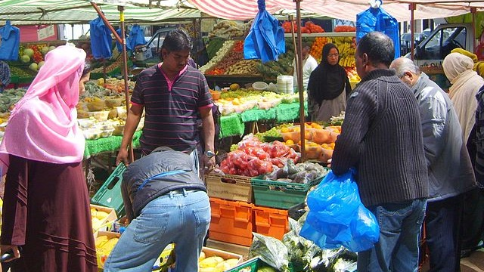
Notes:
Country: UK
Image info: Vegetable stall on Whitechapel Market in Whitechapel Road, London.
Credit: SilkTork commons.wikimedia.org/wiki/Category:East_End_of_London?uselang=en-gb#/media/File:Veg_stall_2.jpg
Licensed under Creative Commons Attribution-ShareAlike 3.0 Unported (CC BY-SA 3.0)

Slide 4
Notes:
Country: Peru
Image info: Sheep in front of Nevado Huascaran, Utupampa, Ancash, Peru.
Credit: Gilvan Barreto/Oxfam

Slide 5
Notes:
Country: Kenya
Image info: Jamaica dump in the middle of Mkuru informal settlement in Nairobi, Kenya. Children from nearby often come here to scavenge for food scraps, or to work with adults sorting rubbish.
Credit: Sam Tarling/Oxfam

Slide 6
Notes:
Country: Vietnam
Image info: People visit a luxury mall in Hanoi, Vietnam.
Credit: Sam Tarling/Oxfam

Slide 7
Notes:
Country: Yemen
Image info: Women return home after collecting water from the local well, a two-hour walk away from their village, Al-Dhafer, in Yemen.
Credit: Gabreez/Oxfam

Slide 8
Notes:
Country: Bangladesh
Image info: A busy traffic junction in Chittagong, Bangladesh, at dusk. Bangladesh is one of the world’s most densely populated countries.
Credit: GMB Akash/Oxfam

Slide 9
Notes:
Country: Nigeria
Image info: The displaced camp of Muna Garage on the outskirts of Maiduguri, Nigeria.
Credit: Pablo Tosco/Oxfam

Slide 10
Notes:
Country: Iraq
Image info: Children play at a camp for displaced families in Iraq.
Credit: Tommy Trenchard/Oxfam

Slide 11
Notes:
Country: Occupied Palestinian Territory / Israel
Image info: Suleiman's house in the Shujaiya neighbourhood of Gaza was completely destroyed during the bombing. With his wife and nine children he fled to a school to seek shelter, but had nowhere to go after the ceasefire. He built a small room with a kitchen and a toilet from the rubble of his bombed house.
Credit: Anas al Baba/Oxfam

Slide 12
Notes:
Country: Nigeria
Image info: The Central Bank of Nigeria headquarters, Abuja, Nigeria.
Credit: GodwinPaya bit.ly/2HuY7KT
Licensed under Creative Commons Attribution-ShareAlike 4.0 International (CC BY-SA 4.0)

Slide 13
Notes:
Country: Bangladesh
Image info: Aerial view of Horijon Polli slum in Mymensingh, Bangladesh.
Credit: Tom Pietrasik/Oxfam

Slide 14
Notes:
Country: Yemen
Image info: Ditwa Lagoon near the port of Qalensiya on Socotra Island, Yemen.
Credit: Dan bit.ly/2S3dnTb
Licensed under Creative Commons Attribution-ShareAlike 2.0 Generic (CC BY-SA 2.0)

Slide 15
Notes:
Country: UK
Image info: Sheep and cattle in Snowdonia National Park.
Credit: Eric Jones commons.wikimedia.org/wiki/File:Sheep_and_cattle_at_the_back_of_Snowdon_View_-_geograph.org.uk_-_568127.jpg?uselang=en-gb
Licensed under Creative Commons Attribution-ShareAlike 2.0 Generic (CC BY-SA 2.0)

Slide 16
Notes:
Country: Nepal
Image info: People walk amongst destroyed buildings in Sankhu, where hundreds of houses collapsed when an earthquake measuring 7 .8 on the Richter Scale struck Nepal on Saturday 25 April 2015.
Credit: Aubrey Wade/Oxfam

Slide 17
Notes:
Country: Ethiopia
Image info: Farming in rural Ethiopia.
Credit: Kieran Doherty/Oxfam

Slide 18
Notes:
Country: Vietnam
Image info: A garment factory in Dong Nai province, Vietnam. Some of world’s biggest fashion brands source their clothes from countries where labour is cheap, such as Vietnam.
Credit: Sam Tarling/Oxfam

Slide 19
Notes:
Country: Malawi
Image info: A mixed-gender school football match in Balaka district, Malawi.
Credit: Corinna Kern/Oxfam

Slide 20
Notes:
Country: The Philippines
Image info: Working on rice fields, in central Mindanao, the Philippines.
Credit: Tessa Bunney

Slide 21
Notes:
Country: Tibet
Image info: North face of Mount Everest, as seen from the path to the base camp, Tibet.
Credit: Luca Galuzzi bit.ly/2CKwhVo
Licensed under Creative Commons Attribution-ShareAlike 2.5 Generic (CC BY-SA 2.5)

Slide 22
Notes:
Country: Brazil
Image info: The Paraisópolis favela (Paradise City shanty town) borders the affluent district of Morumbi, in the city of São Paulo, Brazil.
Credit: Tuca Vieira

Slide 23
Notes:
Country: Kenya
Image info: Elephants in Amboseli National Park, Kenya.
Credit: Ray in Manila https://bit.ly/2G8imeW
Licensed under Creative Commons Attribution 2.0 Generic (CC BY-SA 2.0)

