Slide 1
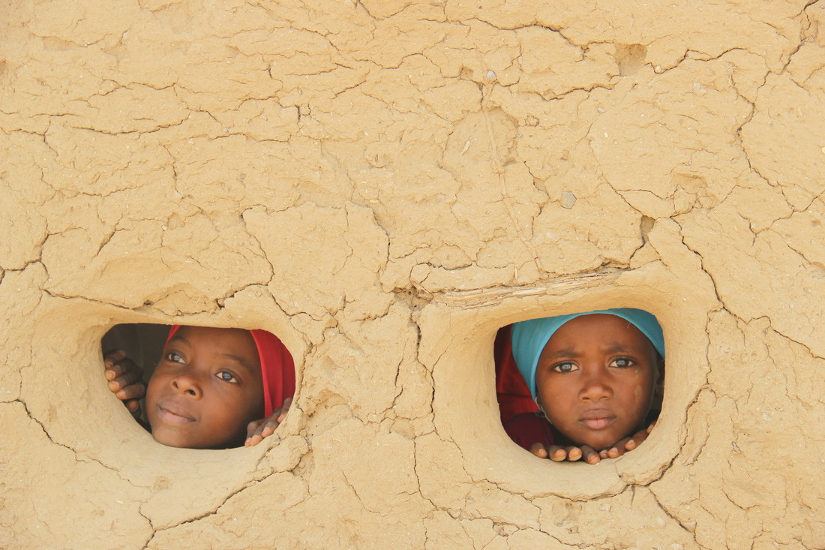
CRISIS IN YEMEN
BRITISH AID AND BRITISH BOMBS
Type presentation author here
Type date here
Notes:
This presentation is about the humanitarian crisis and conflict in Yemen
Begin by asking how many in the audience have heard of Yemen, can locate Yemen on a map, or know the name of Yemen’s capital city (Sana’a)
Despite the conflict in Yemen not hitting the headlines as frequently as Ukraine, Syria or Iraq, 20.7 million of its people are in need of humanitarian assistance (February 2022). This is a greater percentage of the population than any other country in the world, including Ukraine, Syria or Iraq (accurate in March 2022). At the time of writing the conflict in Yemen has continued without interruption for seven years.
Yemen is a complex crisis. The British government and the British people have been generous in the humanitarian aid they have provided to Yemen’s people. Yet at the same time the British government has continued to sell weapons to the government of Yemen’s neighbour Saudi Arabia. Saudi Arabia is involved in Yemen’s conflict. Its military is accused of using British-made weapons against civilians in Yemen, in a conflict where all sides are accused of breaking international humanitarian law.
Therefore there is a puzzling situation where Britain and other countries provide aid and propose peace with one hand and weapons which cause innocent deaths with the other. This presentation will help you to make better sense of this situation and decide what you think is the best way to respond.
Photo of Nour and Samar: Hind Al-Eryani/Oxfam (2016)

Slide 2
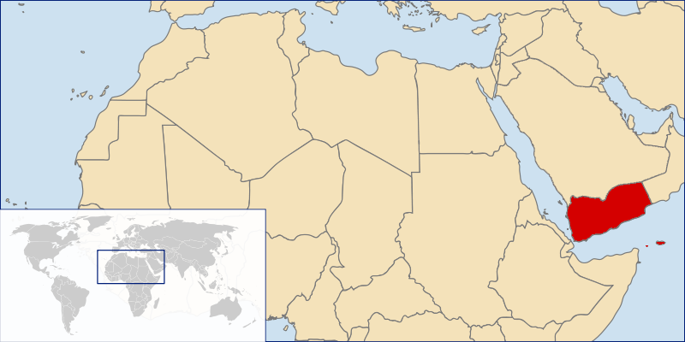
The geography of Yemen
Notes:
Did you know where Yemen is located on a map?
Yemen occupies the southern tip of the Arabian peninsula and its land neighbours are Saudi Arabia to the north and Oman to the east. Its coastline is bordered by the Red Sea to the west and the Arabian Sea to the south. The capital city is Sana’a and the largest port is Aden. Aden was a British colony until 1963, and once supplied ships travelling through the Suez Canal to and from India.
Map: https://commons.wikimedia.org/wiki/File:LocationYemen.PNG

Slide 3
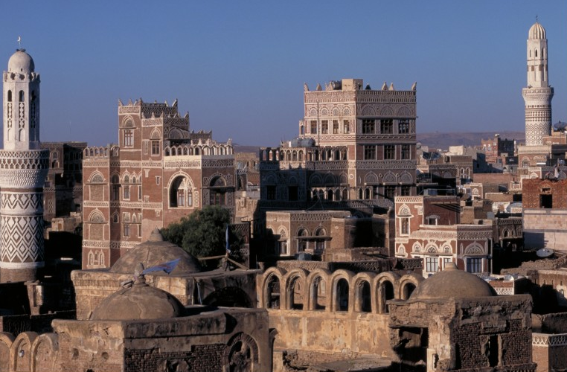
The history of Yemen
Notes:
Yemen is one of the oldest inhabited regions of the world and a cradle of civilisation. Tradition has it that the ancient city of Sana’a was founded by Shem, the son of Noah. Despite this long history of civilisation, Yemen’s more recent past has seen almost continual conflict and crises. The 1960s saw violent resistance to British rule in Aden before Britain finally left in 1967. Yemen was then divided into two parts, North and South, which were finally united in 1994. Civil war then broke out. By the 2000s the civil war continued as guerrilla warfare in the countryside. In 2011 the ‘Arab Spring’ saw a spread of popular protests before armed conflict intensified from 2015 onwards, and increasingly involved Yemen’s neighbour Saudi Arabia.
Photo: Sana’a old city (2001) Toby Adamson/Oxfam

Slide 4
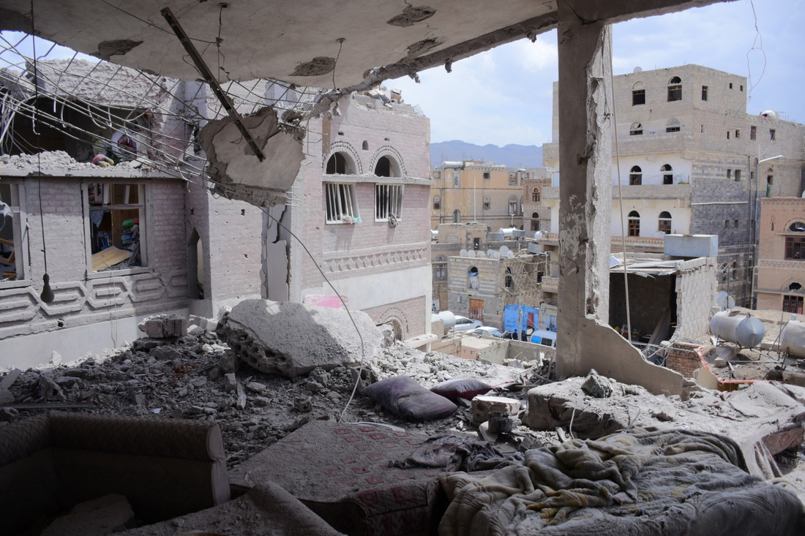
The conflict – Sana’a
Notes:
It is estimated Yemen’s conflict has caused 377,000 direct and indirect deaths between March 2015 and the end of 2021 (source: Campaign Against the Arms Trade)
The photo shows airstrike destruction of civilian houses in Sana’a on 16 May 2019
Photo: Bassam Al-Thulaya / Oxfam Yemen (May 2019)

Slide 5
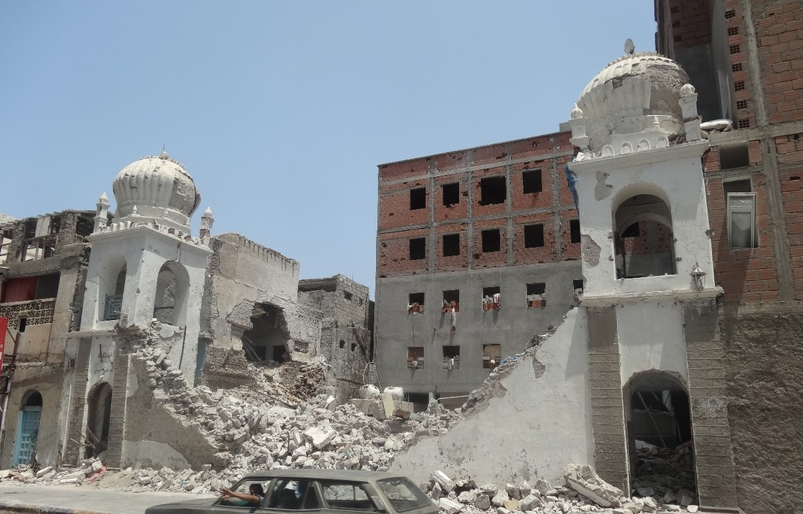
The conflict - Aden
Notes:
The impact of the conflict goes far beyond the numbers of deaths and injuries caused by fighting and air raids.
The photograph shows a destroyed building in the port city of Aden. With ports blockaded, Yemen has been unable to import food, fuel, medicines and other vital supplies for long periods of time. This has severe knock on effects. People go hungry; trade slows to a standstill without fuel for vehicles; schools, hospitals and water facilities are forced to close without fuel and supplies; and shops are empty of goods. In March 2022 the situation is still at crisis point.
Photo: A destroyed building in Aden (August 2015) Mohammed Taleb/Oxfam

Slide 6
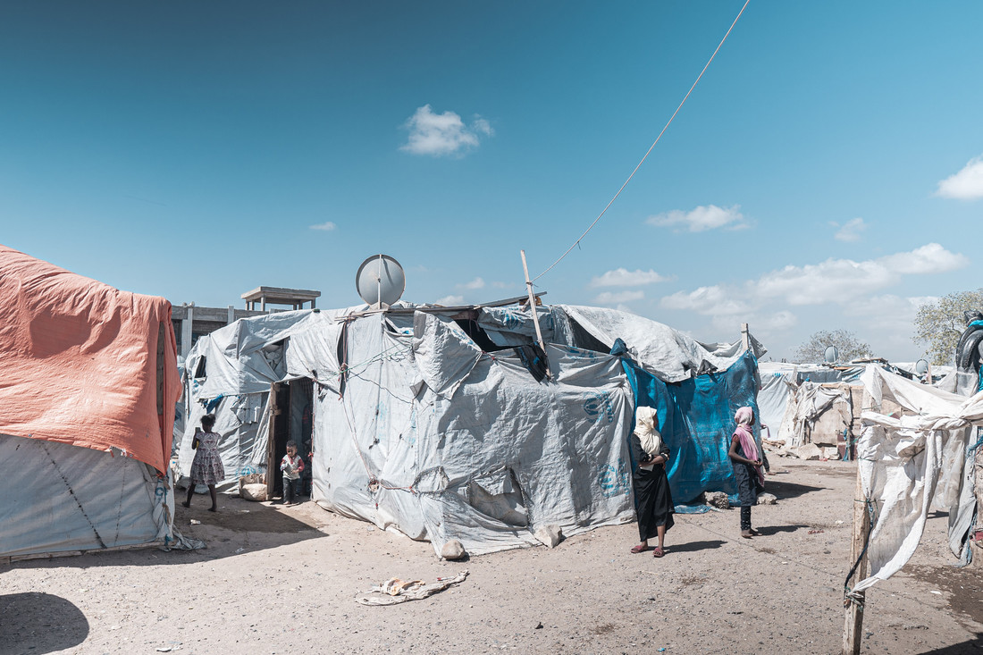
The crisis – forced to flee
Notes:
Almost 4 million people in Yemen have been forced to flee their homes by the conflict. The vast majority are internally displaced within Yemen and many are still not safe, particularly women and girls.
The photo shows Khalid’s tent in Ammar bin Yasser camp. Khalid lives there with his wife and five children.
Khalid says “In the beginning, when we arrived at the camp, we didn't have tents but we used our clothes to make a cover to cover our family and slept in the schoolyard. We received the tents after six or seven months, but these tents are designed to last for six months not for two or three years. Now the tents are damaged and the cold penetrates. The children got sick. It was an indescribable situation. We were suffering from a difficult situation."
Photo: VFX Aden/Oxfam (February 2021)

Slide 7
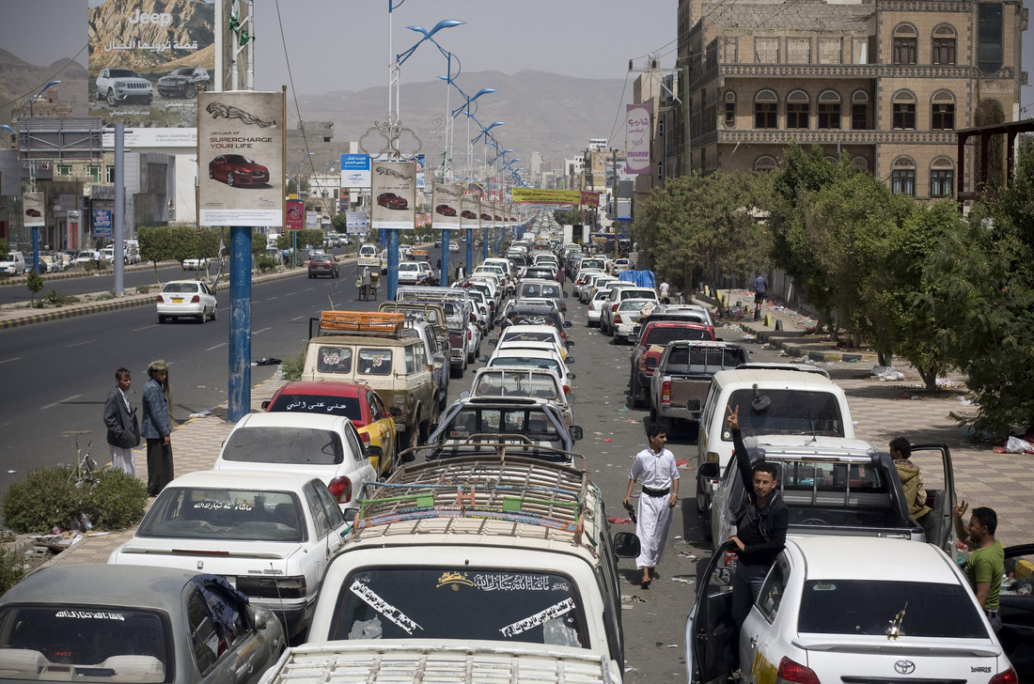
The fuel crisis
Notes:
This photo of Yemen’s capital city Sana’a doesn’t show a normal traffic jam. Instead these cars are queuing up for petrol at a petrol station during fuel shortages in April 2015
One element of Yemen’s conflict has been the blockade of the main ports such of Aden (see slide 5) and Hudaydah. Yemen relies on imports for most of its fuel, food, medicines and other vital goods. Even when ships can dock, their goods are often stuck in ports due to the lack of fuel to unload and transport them. In addition ongoing violence affects major roads and cities, and this limits transportation and distribution around the country.
In June 2018 the land offensive against Hudaydah threatened to cut off the food and essential supplies that are imported through the city’s port, placing residents of the city in the frontline and threatening the 20 million Yemenis who depend on supplies from Hudaydah with the risk of famine.
In late July 2018 air strikes damaged the water station and pipes that supply the majority of Hudaydah city’s water. This triggered a new cholera outbreak in a country which had already experienced unprecedented outbreaks of the disease. In the first 6 months of 2019 a damaged water infrastructure and flash flooding led to 460,000 new cases of cholera.
Photo: Abo Haitham/Oxfam (2015)

Slide 8
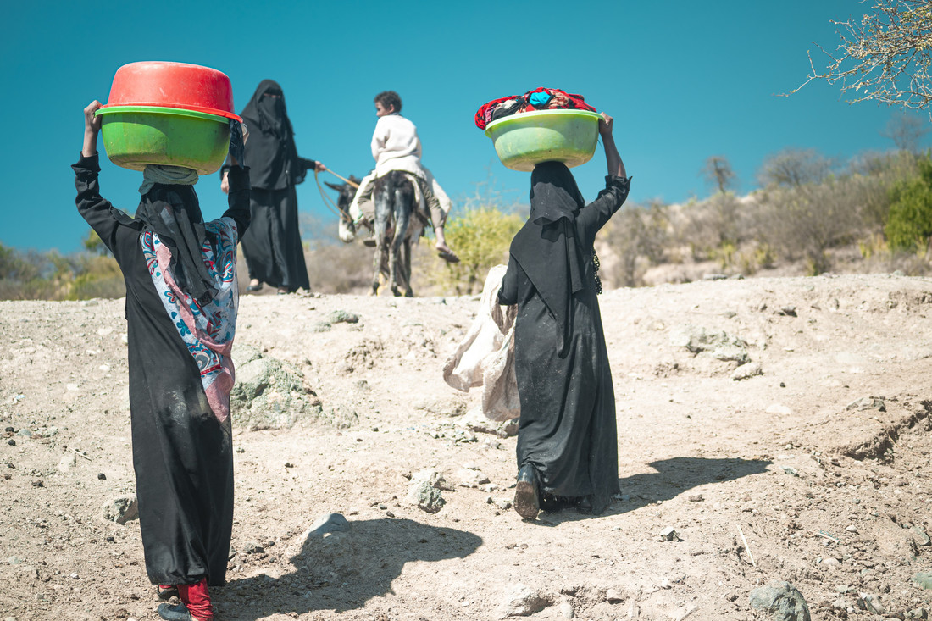
The water crisis
Notes:
Yemen is one of the world’s most water-scarce countries. By the end of 2021, 16 million people in Yemen were in urgent need of water, sanitation and hygiene (source - UNICEF). One main reason is that there is no fuel to pump water from underground wells.
Yemen’s crisis can be understood as a ‘perfect storm’. Many factors combine together to make the overall situation much worse. For example the shortage of fuel is a big problem in itself, but it also has the knock-on effect of stopping millions of people’s access to water.
The photo shows women taking their laundry from the well in Al-Dhale. Fierce fighting led to the destruction of the public water supply network. Even before the escalation of conflict, the water scheme that fed Al-Dhale city had started to collapse due to lack of money to maintain it. In the midst of conflict, the water facilities have been further exposed to robbery and looting. This is in addition to physical damage the conflict has left on buildings and water tanks.
Photo: VFX Aden/Oxfam (January 2021)

Slide 9
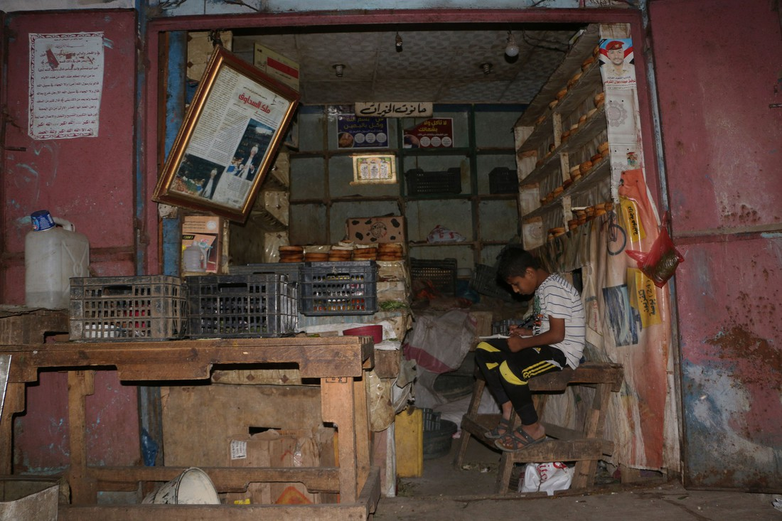
The trade crisis
Notes:
This shop in the city of Taiz used to serve long queues of people. By the time the photograph was taken in February 2016 it stood empty. Blockades of the ports, insecurity on the roads and a shortage of fuel for transport mean that prices for essential goods have increased rapidly and shops are empty. This is another example of the ‘perfect storm’.
From 2015 and 2016 onwards Oxfam reported alarming signs of rising malnutrition and starvation across the country. People’s coping strategies were being exhausted as they spent their savings and sold their belongings. By June 2019, 14.3 million people, almost half of the population, were in acute need of assistance. The term ‘acute need’ is used in aid agency reports and is often explained with the phrase ‘not knowing where your next meal is coming from’.
Photo: Abdulnasser Al-Sedek/Oxfam (February 2016)

Slide 10
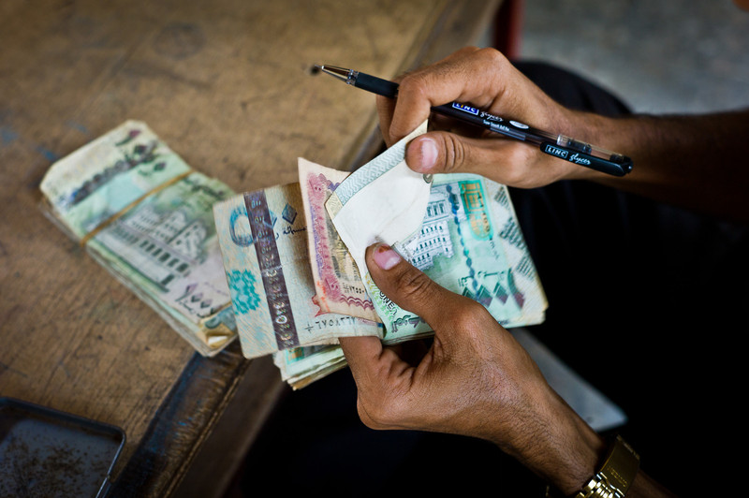
The cash crisis
Notes:
On top of all the other crises we’ve looked at, since March 2016 Yemen’s government has been running out of money. This is important because businesses need foreign currency to import food and fuel. As the government ran short of cash, it was unable to provide sufficient foreign currency for imports. This slows down trade even more and pushes prices even higher. Between 2015 and 2019 the size of Yemen’s economy shrunk by approximately 50%
All the different crises had been building up during 2015 and 2016. In 2017 and 2018 they had reached breaking point. But there is yet one more crisis which hit Yemen in 2020. Can anyone think what it is?
Photo: Wolfgang Gressmann/Oxfam (2012)

Slide 11
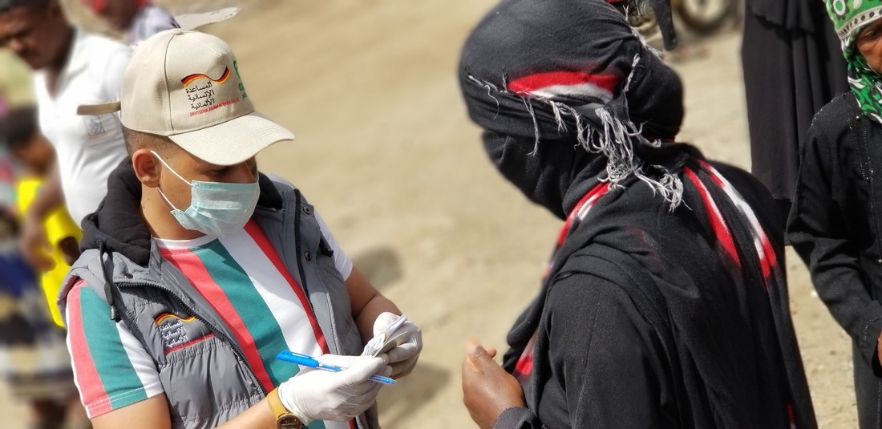
The Coronavirus crisis
Notes:
Yemen’s first case of COVID-19 was reported on April 10th 2020. By June it was estimated that infections already topped one million, many times the numbers recorded by official statistics. War and now coronavirus have overwhelmed the country’s depleted health facilities. In a country where doctors have struggled for many years to obtain equipment, there is a severe shortage of Personal Protective Equipment (PPE) and Intensive Care facilities to respond safely to coronavirus. Only around half of healthcare facilities are currently functioning across the country. The mortality rate from COVID-19 in Yemen has been estimated by the UN to be as high as 30%, well above anywhere else on the planet. At the end of 2021, only 2% of Yemen’s population had been vaccinated against Covid-19.
In the photo Oxfam staff are distributing soap and hygiene kits to help battle COVID-19 at a camp for internally displaced people in Taiz.
Photo: Wael Algadi/Oxfam (March 2020)

Slide 12
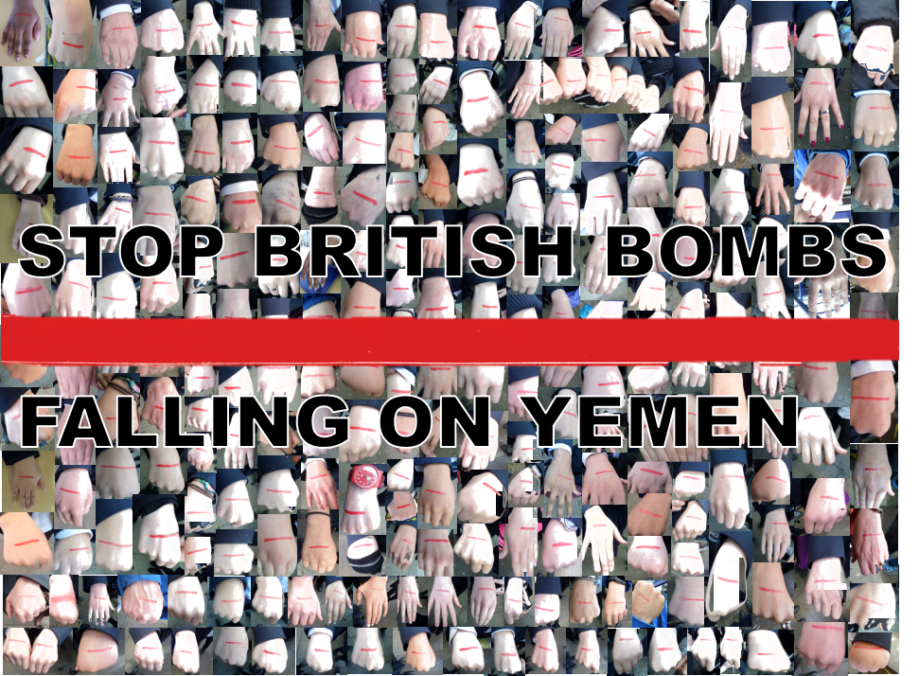
Your response – campaigning
Notes:
Britain’s role in Yemen is controversial.
Yemen’s neighbour Saudi Arabia is deeply involved in Yemen’s conflict. Saudi Arabia and its allies have repeatedly bombed and attacked targets in Yemen and has killed Yemeni civilians. All sides in the conflict are accused of harming civilians, but according to the UN the majority of civilian casualties have been due to attacks by a Saudi-led coalition of countries.
Oxfam believes that Britain could do more to push for a ceasefire in Yemen that will stop the fighting and help to build a lasting peace. Oxfam calls on the UK Government to push for an immediate ceasefire and take forward the UK’s responsibility as the ‘penholder’ for Yemen at the UN to find a lasting peace deal and protect millions of vulnerable families.
Britain has been selling bombs to Saudi Arabia. Oxfam calculated that the UK has granted 1,697 arms export licences worth £6.2 billion to members of the Saudi-led coalition between 2015 - 2019. The value of these export licences is more than eight times the amount of aid (£770m) given by the UK to Yemen over the same period.
Oxfam says that the export of arms to Saudi Arabia for use in Yemen is breaking UK, EU and international law as there is a high risk that the bombs are used kill and injure civilians. This is because the UK agreed to the Arms Trade Treaty, which says arms sales should not occur if there is a risk the weapons may be used to break international humanitarian law. Oxfam has been calling on the government to immediately suspend its arms exports to Saudi Arabia. Oxfam has joined a number of other organisations to take the Government to court and make arms sales to Yemen illegal. The latest judgement in this long-running case is due in 2022.
The photograph shows a photo stunt by students at Sir John Lawes School. 280 students painted their hands with a red line to show that the Yemen conflict had gone too far and must stop. They sent their photo petition to their MP calling on him to take action.
Therefore one response to the Yemen crisis is to take a campaign action, calling on the British government to push for an immediate ceasefire in Yemen and to suspend arms sales to Saudi Arabia.
Photo: Sir John Lawes School Oxfam Group (June 2017)

Slide 13
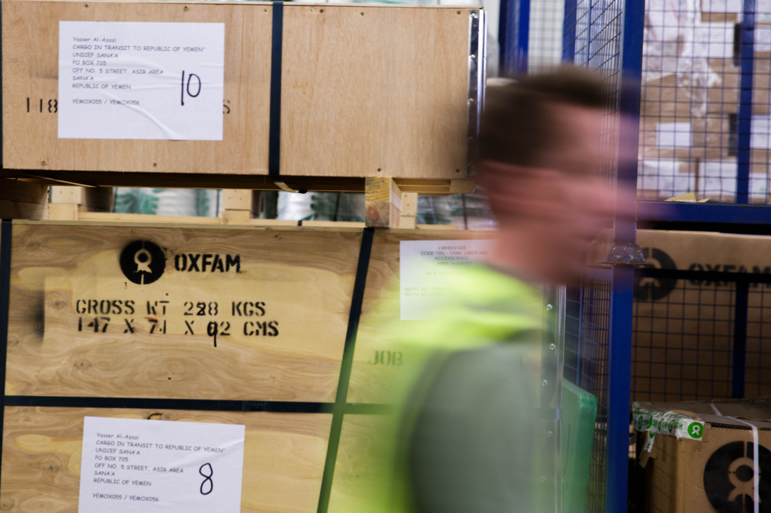
Your response – humanitarian aid
Notes:
As we’ve seen, the crisis in Yemen is complicated and there is no single ‘right’ way to respond. The second action is to fundraise for the Oxfam Yemen crisis appeal.
The British government is a lead donor in Yemen and aims to provide £88 million in aid during 2022/23. Oxfam has a large programme in Yemen; providing over 3 million people with access to safe, clean water. But the situation in Yemen has been steadily getting worse. By the middle of 2019 it reached crisis point. 14.3 million people, almost half of Yemen’s population, were in acute need of humanitarian assistance. The Covid-19 pandemic which began in 2020 is making the situation even worse.
Oxfam has launched a specific fundraising project for its work in Yemen.
The photograph shows the project in action. Water equipment is being prepared for delivery to Yemen from Oxfam’s warehouse in Bicester.
So another response to the Yemen crisis is to raise money for Oxfam’s Yemen appeal
Photo: Tegid Cartwright/Oxfam (May 2015)

Slide 14
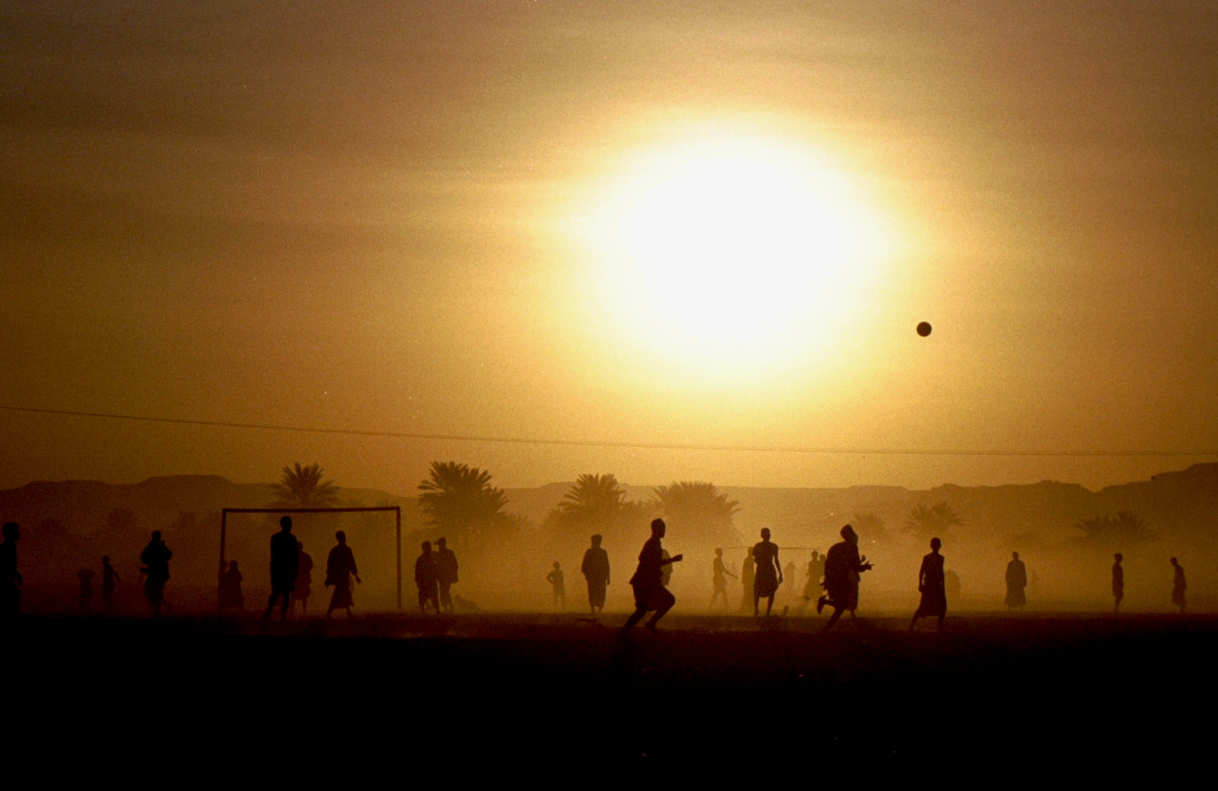
Thank you
Notes:
As you have learnt, the crisis in Yemen is complicated and there is no single ‘right’ way to respond. However, whether you decide to fundraise for the Oxfam appeal, participate in a campaign action or do a combination of both, please do not ignore this most urgent of emergencies. Thank you
Photo: Chris Worrall/Oxfam. Football at sunset in Shibam (2004)

