Slide 1
Notes:
No matter who we are or where we live, we all want to live in a place of safety with our loved ones. A place we can call home. The COVID-19 pandemic temporarily separated many of us from our families and loved ones, so this is a human need everyone has experienced.
But conflict, disaster and poverty have made home and family distant memories for millions of the world’s most vulnerable people.
At the end of 2020, 82.4 million people were displaced from their homes by war, violence and persecution. This is a massive number. The global population of people forced to flee has grown quickly in a short period of time, from 43.3 million in 2009 to the record numbers of today.
The millions of people fleeing war in Ukraine will increase the numbers of refugees and displaced people in the world even further.
Statistics
UNHCR (2021) – ‘Global Trends. Forced Displacement in 2020’
Glossary
Displaced person: a displaced person seeks safety by moving to another part of the country where they live.
Refugee: a refugee seeks safety by crossing a border into another country.

Slide 2
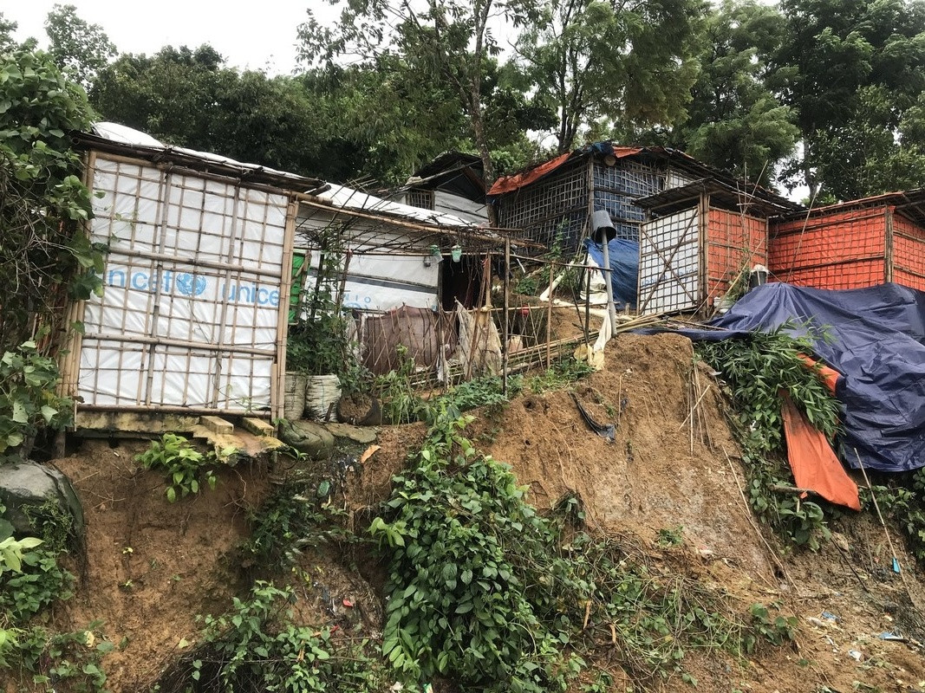
Cox’s Bazar, Bangladesh
Notes:
The vast majority of the people forced to flee their homes by war, conflict and persecution are hosted by a lower or middle income country. For example, the photo shows some of the appalling conditions in the world’s largest refugee camp. It’s in Cox’s Bazar in Bangladesh and in June 2021 was ‘home’ to 890,000 Rohingya refugees who have fled across the nearby border to escape persecution in Myanmar
Oxfam has humanitarian programmes providing water, sanitation and food in many of the countries that host the largest numbers of refugees, such as Bangladesh, Syria, Uganda, Lebanon, Jordan and Tanzania.
Photo: Mutasim Billah/Oxfam, 9 July 2019
Data
UNHCR (2021): https://data2.unhcr.org/en/situations/myanmar_refugees

Slide 3
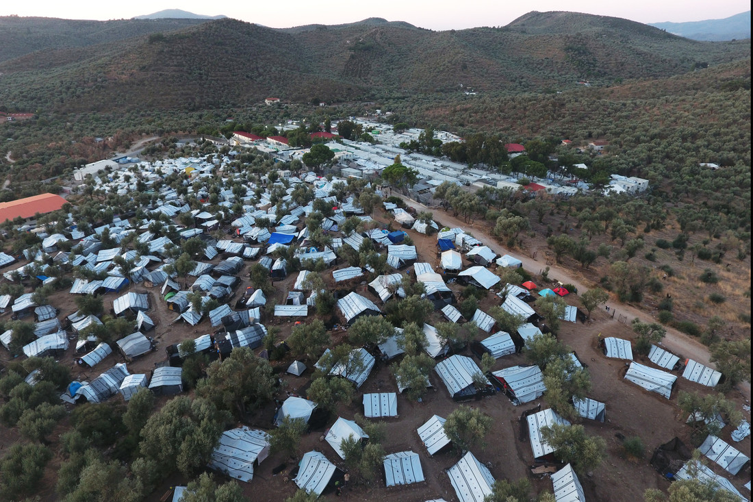
Lesbos, Greece
Refugees in Europe
Notes:
Although the numbers have been smaller, refugees are also seeking sanctuary within Europe.
This is an aerial view of the makeshift settlement next to Moria camp on the island of Lesbos, Greece. Thousands of refugees who have crossed the sea from Turkey were living here in extremely poor conditions without running water and electricity. They lived in the dark while being exposed to worsening weather conditions during winter. In September 2020, the Moria camp was destroyed by fire, leaving 13,000 people homeless and without even the very basic shelter which is shown in the photo.
Having escaped unbearable danger and hardship, many people hope they have reached safety in Europe. But instead, they are turned away or met by hostility, discrimination, abuse – and worse.
And when people flee danger, their families are separated and split up while they’re running for their lives or undertaking long and dangerous journeys. Often family members end up in different countries or in different refugee camps; able to speak occasionally on the phone but otherwise separated.
Photo: Giorgos Moutafis/Oxfam 29 November 2019

Slide 4
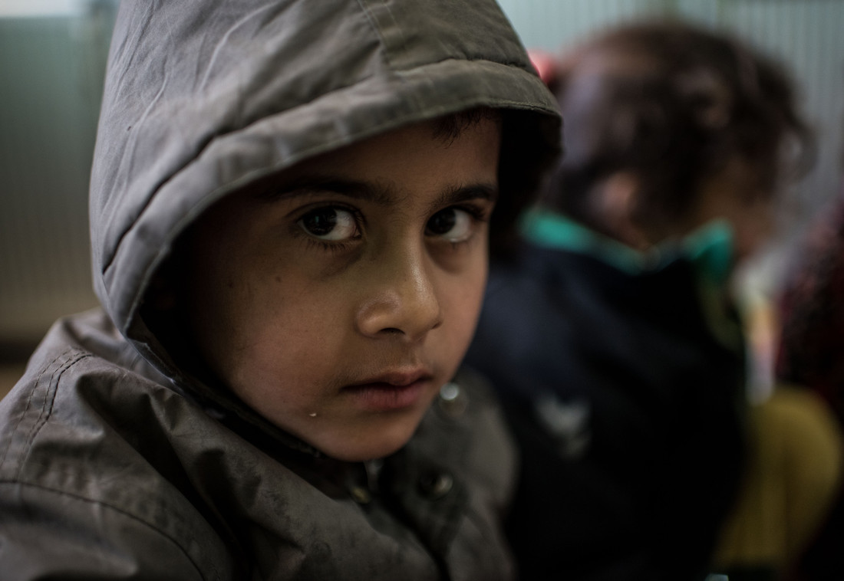
4/10 of refugees are children
Notes:
The number of child refugees has been steadily increasing, and in 2020 children made up 42% of the world’s refugees. Children only make up around 1/3 of the world’s people, so they are significantly overrepresented in the refugee population.
Many child refugees are ‘unaccompanied’. This means they are separated from their families and arrive at a border by themselves or with groups of people who are not their relations or responsible for them.
Photo: Tommy Trenchard/ Oxfam, 24 February 2017
Data:
UNICEF (2021) – https://uni.cf/2YQuYi7

Slide 5
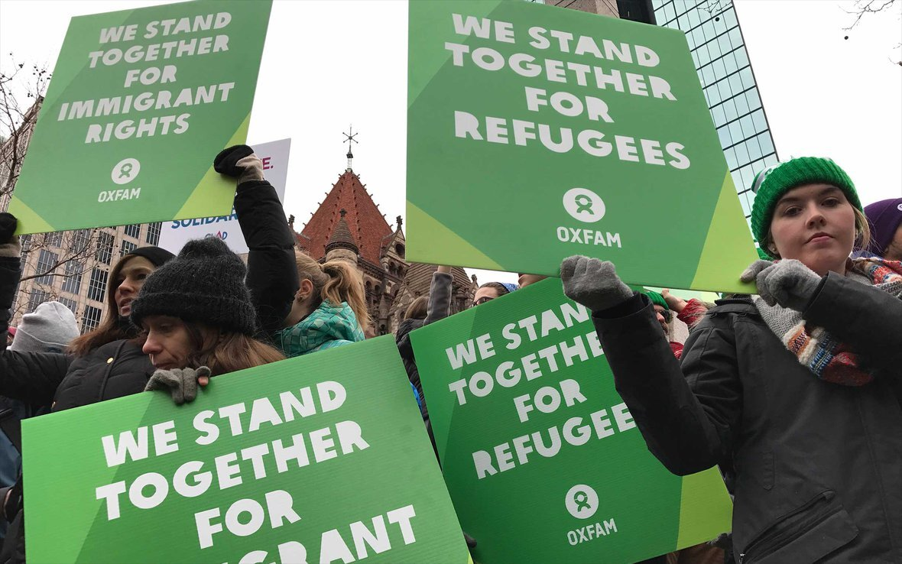
Refugees in the UK
Notes:
The number of refugees and people seeking asylum in the UK has been relatively small.
Between March 2019 and March 2020, in the year before the Covid-19 pandemic struck, 141 million people from other countries visited the UK on holiday, 689,000 came legally to live and only 35,000 applied for asylum. Between March 2020 and March 2021 the number of asylum seekers arriving in the UK declined again to 27,000. A person who has claimed asylum then has to wait while their claim for refugee status is decided.
While people seeking asylum in the UK wait for their claims to be decided they are not permitted to work and have to rely on the government for support. They are provided with a place to live and £40.85 per week to cover all their other needs. This is far too small an amount of money to live on with dignity. Asylum claims can take many months or even years to decide.
Once refugee status is confirmed, a refugee may work and claim similar benefits and government services as everyone else. However the UK’s rules about refugee family reunion are strict. A refugee is only permitted to sponsor their husband or wife and children under 18 to join them in the UK. This means that families that become separated as they flee danger often remain separated from other family members. This is despite the evidence showing that people living together with their loved ones find it much easier to integrate with a new society, and the numbers of people potentially involved are small – currently between 5,000 – 9,000 per year
Photo: Oxfam GB
Data:
National Statistics (2020)
Refugee Council (2021) https://www.refugeecouncil.org.uk/information/refugee-asylum-facts/
UK Government (2021) https://www.gov.uk/asylum-support/what-youll-get

Slide 6
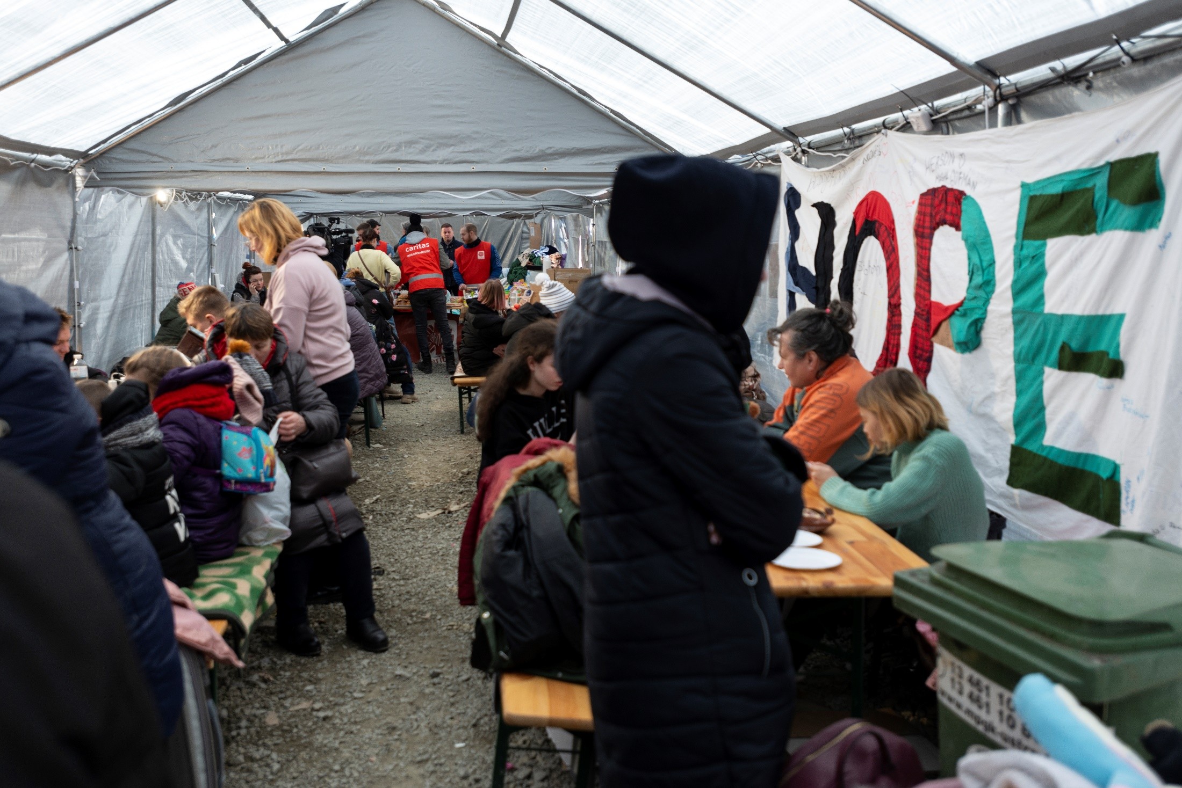
Refugees from Ukraine
Notes:
In February 2022 the war in Ukraine suddenly triggered Europe’s largest movement of refugees since World War 2. By 10 April 2022 just over 4.5 million people had sought safety in neighbouring countries. It is estimated that 200,000 Ukrainian refugees will settle in the UK and 100,000 Ukrainian children will enrol in UK schools. The welcome extended to Ukrainians fleeing conflict by British people has been generous, compassionate and kind. The UK Government has shown some generosity to Ukrainian refugees and their families, including broadening the definition of the family members permitted to settle in the UK. However the position of asylum seekers and refugees who have fled other conflicts in Syria, Iraq, Afghanistan and further afield is less secure. The United Nations Convention on Refugees and international law require governments to welcome all refugees wherever they have come from.
Photo: Refugees at a reception centre on the Ukraine/Poland border – Bekki Frost/Oxfam, March 2022
Data
UNHCR (2022) – ‘Operational Data Portal. Ukraine Refugee Situation’

Slide 7
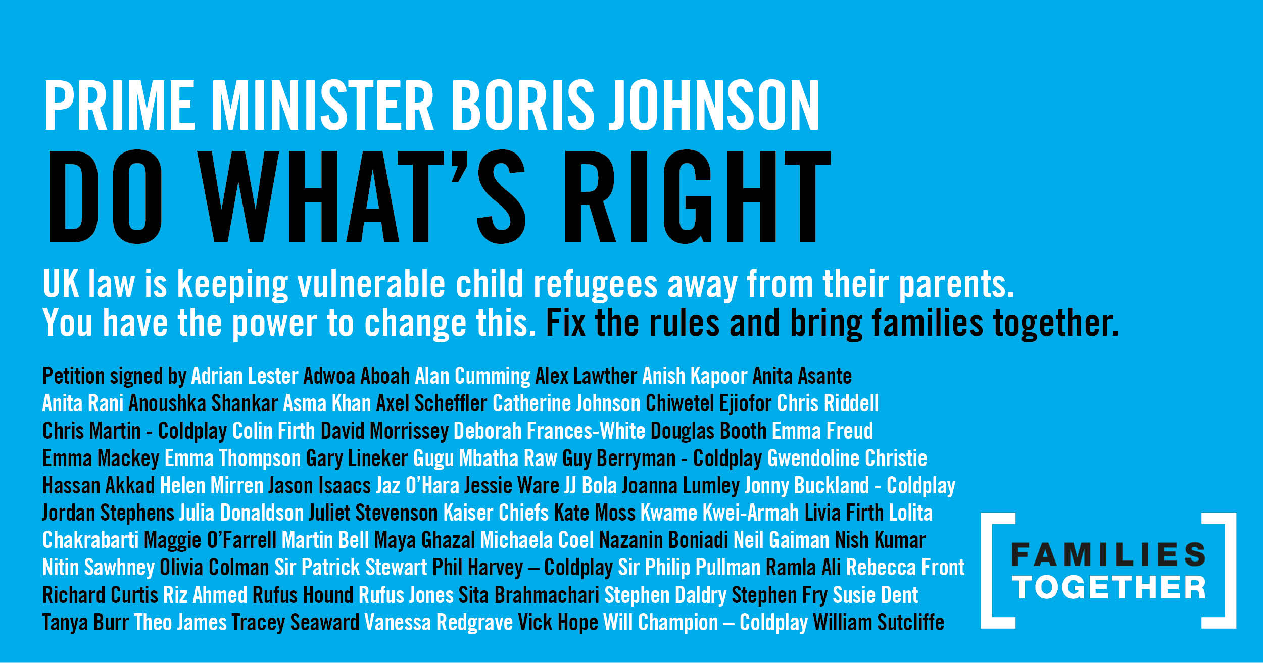
A change in the rules
Notes:
The Families Together campaign is calling for a change in the rules about refugee family reunion.
At present the only family members of refugees legally entitled to resettlement in the UK are a refugee’s husband, wife or same-sex partner and their children under 18 years old. Other family members do not qualify.
Therefore the campaign calls for the following
Unaccompanied child refugees in the UK should have the right to sponsor their parents to join them, so they can rebuild their lives together as a family. At present unaccompanied child refugees are placed in local authority care until they are 18
The definition of who qualifies as a family member is expanded so that young people who have turned 18 and elderly parents can live in safety with their families in the UK
Legal aid is reintroduced so refugees have the support they need to navigate the complicated process of sponsoring family members to join them
However the Nationality and Borders Bill which was completing its passage through Parliament in April 2022 threatens to reduce rather than increase these rights.
But the rules can be changed by the Home Secretary without a new law. So it’s important to show MPs from all parties that young people are calling for change. This is what will convince MPs to take action in Parliament to help change the rules.
In September 2020 this petition signed by prominent UK citizens (see above) was sent to the government. We hope you will join its signatories by organising messages to your MP from your own school and community.
Photo: Families Together Coalition

Slide 8
Bring families together
Notes:
Here’s how you can have your say and help to bring refugee families together.
Think about creative ways of how you could collect messages to send to your MP. We have some templates you could use, but also think creatively and design your own ideas. The campaign has been using the idea of jigsaw pieces to represent the missing pieces in families lives, so you could be creative and design your own jigsaw pieces.
When you’ve finished collect all your messages together to send to your MP. If it’s possible meet your MP online or face to face to explain your campaign and why you’re calling for refugee family reunion.

Slide 9
Notes:
Families Together is one of many campaigns which challenge different aspects of the UK’s asylum and refugee system.
Here are several others. You could also research these campaigns and get involved to support their aims.

Slide 10
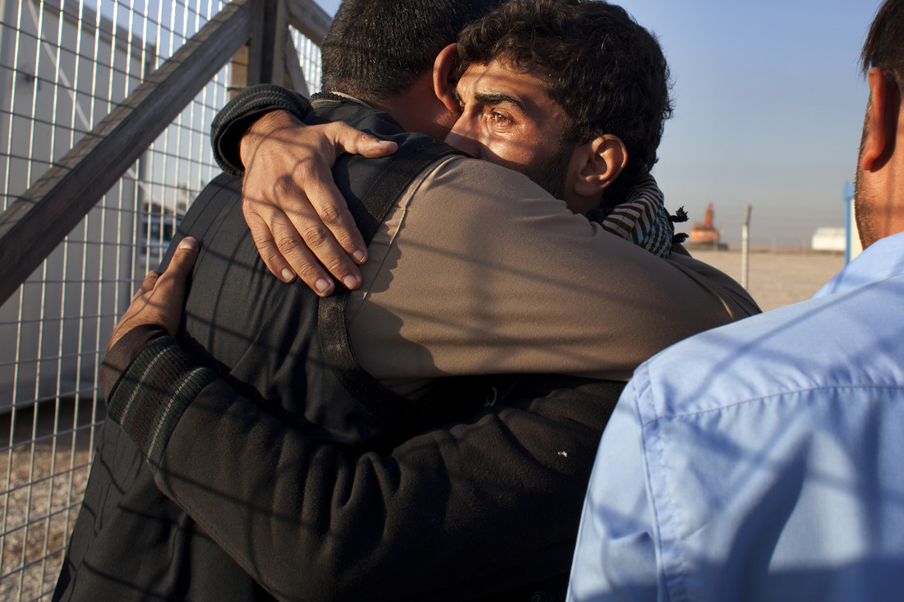
Thank you ☺
Notes:
Finally this photograph shows two relatives embracing as they were reunited at a refugee camp outside Mosul, Iraq. It shows the importance of families to everyone. Thank you for listening and for helping to reunite refugee families.
Photo: Hassan Sham/Oxfam. November 2016

