Slide 1
Explore the work of Oxfam
Classroom activities for ages 8–14
Notes:
These engaging activities explore how Oxfam is working with people around the world to create a fairer, more peaceful and more sustainable future for everyone.
Learning aims
To think critically about what we all need to thrive in life.
To consider the different aspects of a person’s identity and how these overlapping identities can intersect to affect their opportunities and experiences.
To work collaboratively to analyse photographs illustrating different aspects of Oxfam’s work.
To investigate some of the ways in which Oxfam is working with others around the world to end poverty and create a kinder, fairer and better world.
To reflect on what you think the future would ideally be like and identify possible actions that could be taken to help achieve this.

Slide 2
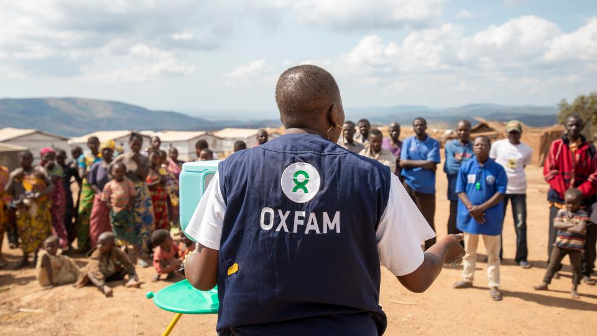
What is Oxfam?
Oxfam is working together with millions of people around the world to end poverty.
Notes:
Oxfam is a global charity that was established in 1942 in Oxford, England. Oxfam is part of a movement of millions of people around the world who are working together to end poverty.
Photo: Pascaline Namegabe works for Oxfam in the Democratic Republic of Congo as a Public Health Officer. In this photo she is demonstrating how to use a new hand washing stand. Pascaline is working with people who have been forced to flee their homes because of fighting in their country.
Credit: Arlette Bashizi/Oxfam

Slide 3
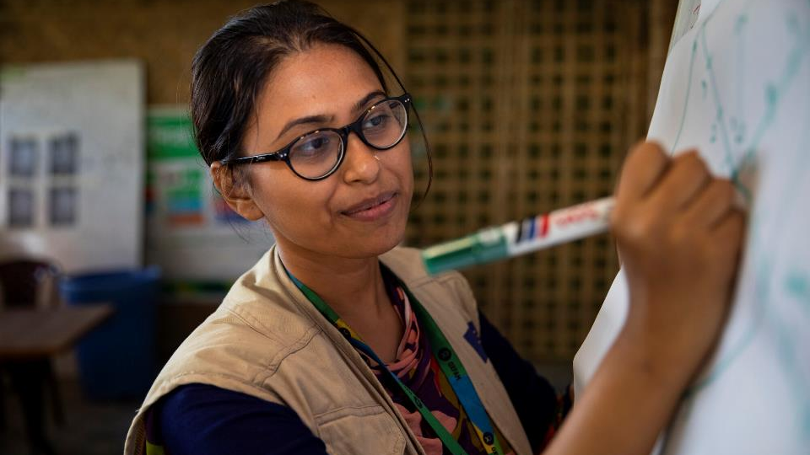
Oxfam’s vision is of a kinder, fairer and better world, where everyone is able to thrive, not just survive.
Notes:
Oxfam believes that poverty is an injustice that can and must be overcome. Their vision is of a kinder, fairer and better world, where everyone is able to thrive, not just survive.
Photo: Iffat works for Oxfam in a refugee camp in Bangladesh. Oxfam is working with organisations in Bangladesh to help provide support such as food, clean water and toilets.
Credit: Salahuddin Ahmed

Slide 4
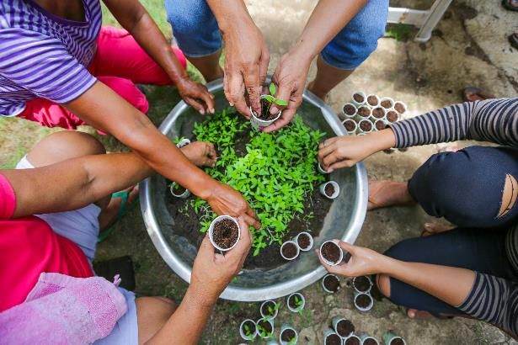
What does “thrive” mean?
“to grow or develop very well”
What does a plant need to thrive?
Notes:
Photo: Farmers transplant seedlings in a vegetable nursery in the Philippines. The nursery is part of a project supported by Oxfam to help farmers recover after the extensive damage caused by typhoons in 2020.
Credit: Juanito Bantong/Oxfam

Slide 5
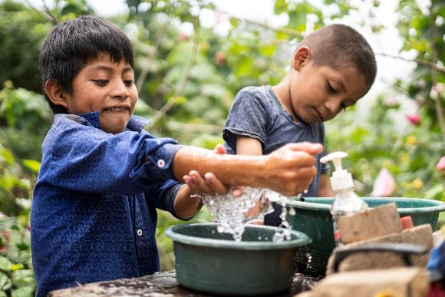
What do we need to thrive?
Talk to a partner about what you think.
Notes:
Photo: These children live in a rural area in Guatemala. Drought caused by climate change is making it difficult for families in their community to get enough food. The situation was even worse during the Covid-19 pandemic, when it was difficult for people to go out to work. Oxfam worked with local partner organizations to deliver food kits.
Credit: Carlos Zaparolli/Oxfam

Slide 6
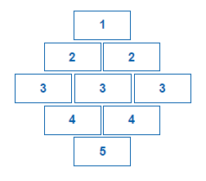
What’s most important?
Most important
Least important

Slide 7
Discussion time
Are these all rights? Or are some of them privileges?
Which things did you decide were most important, and why?
Can you think of anything else we need to thrive?
Do you think everyone has the things they need to thrive in life?

Slide 8

Does everyone have the things they need to thrive?
610 million people around the world live in extreme poverty. This means that they don’t have the essential things they need to survive and thrive.
If our world was made up of 100
people, more than 7 people would
be living in extreme poverty.
Notes:
Extreme poverty is usually described as living on less than US$1.90 per day for all your needs. Living with extreme poverty means not having essential things such as enough food to eat, clean water to drink and somewhere safe to live. Children growing up in extreme poverty may not be able to get medical treatment if they are ill. Their families may not be able to afford to buy the materials they need to go to school, such as books and a uniform. Some children may need to work to support their families instead of going to school.
Data source: World Data Lab https://worlddata.io/ (Accessed 5/10/22)

Slide 9
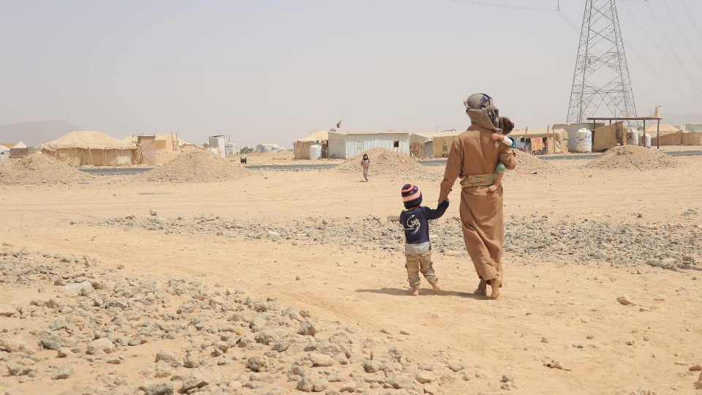
Does everyone have the things they need to thrive?
Huge progress has been made in ending extreme poverty around the world.
But the effects of the Covid-19 pandemic, the climate crisis, conflict and the rising cost of living are now pushing more people into (or further into) poverty.
Notes:
Photo: Mofdal and his family live in Yemen. Like many people in Yemen, the family were forced to leave home because of the intense fighting going on in their country and they now live in a camp. He can’t afford enough food and milk for his children. Millions of Yemenis are living in extreme poverty without the things they need to survive.
Credit: Jehad Al-Nahary/Oxfam

Slide 10

What is inequality?
Notes:
We can think of inequality as the difference between the things some groups of people have compared to other people.
It is a bit like looking at how a big a slice of cake one person has compared to another.
Inequality exists between different countries in the world, for example average income (the amount of money people earn or receive) is higher in some countries than others.
There is also inequality within countries. This means things are not shared fairly within the same country.
For example, some people may have more money than others.
Image: https://pixabay.com/vectors/coins-gold-stacked-metal-treasure-29516/

Slide 11
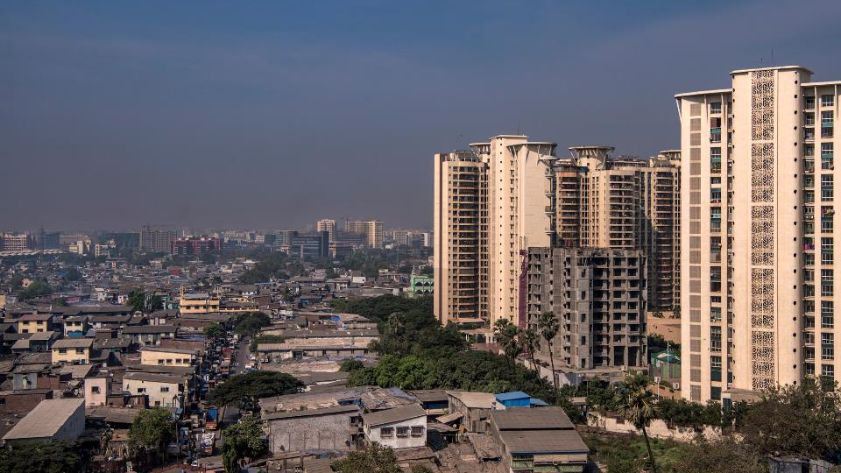
Inequality isn’t just about the amount of money someone has. In what other ways might people’s lives and experiences be unequal?
Notes:
People often think of inequality in terms of how much money different people have, but there are lots of other ways in which people’s lives and experiences are unequal.
Discuss learners’ ideas about ways in which people’s lives might be unequal. Some suggestions are provided on the following slide.
Photo: A low-income neighbourhood next to the high-rise residences of a more affluent area, in the western suburbs of Mumbai, India.
Credit: Atul Loke, Panos/Oxfam

Slide 12
What is inequality?
Being able to go to school and get a good education
How other people treat you
Having free time to rest and play
Being able to go to the doctor
How much of a say you have in decisions that affect you
What job opportunities you have
How much other people listen to your ideas

Slide 13
What is identity?
We can think of identity as the things that make one person or group different from another.
Your characteristics
Who you are
The way you think about yourself
How you are viewed by others

Slide 14
We all have lots of different identities
How old you are
Where you live
Your family
What you look like
What gender you are
Your beliefs
Your ethnicity
What languages you speak
Your likes and dislikes
Your gender identity
Your hobbies and interests
Your sexual orientation
Notes:
We all have lots of different identities that make up who we are. Here are some examples.
Note: This suggested list may need to be amended depending on learners’ age and the context in which the resource is being used.

Slide 15
Who am I?
Name

Slide 16
Thinking time
Which identities do you think about the most?
Which identities do you think about the least?
Are any of these identities “labels” given to you by others?
Do you think your identities stay the same or change during your life?
Which identities do you think have the most effect on how you treat and are treated by others?
Notes:
Questions could be simplified or extended depending on learners’ age and understanding.

Slide 17
A person’s overlapping identities affect…
the opportunities or experiences they have
how they are treated and how they treat others
the barriers they face in getting the things they need to thrive
Notes:
There are many factors that might affect the opportunities or experiences that someone has. A person’s overlapping identities also affect how they are treated and how they treat others.
We all have the same human rights, such as the right to food, the right to education and the right to express our views and be listened to. However, our identities and experiences mean that some people face more barriers in accessing their rights than others. These identities may also affect how much someone is listened to and how much of a say they have in decisions that affect them.

Slide 18

What does Oxfam do?
We respond to emergencies
We work with people around the
world to help make change happen.
We are speaking out for a
kinder, fairer and better world

Slide 19
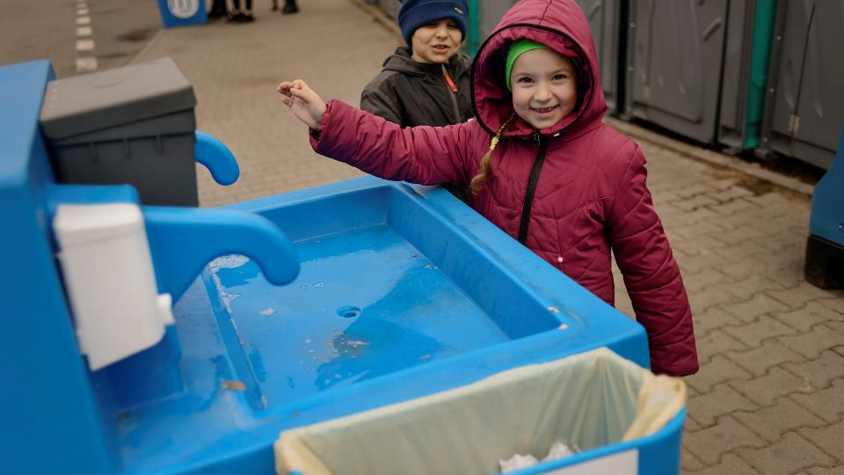
We respond to emergencies
Notes:
Oxfam works with others to provide short-term, life-saving support to help people in emergency situations. For example, this could be because of an earthquake, flooding, drought or conflict.
For example, Oxfam helped to set up this handwashing point at a registration centre for Ukrainian refugees in Poland.
Credit: Tineke Dhaese/Oxfam

Slide 20
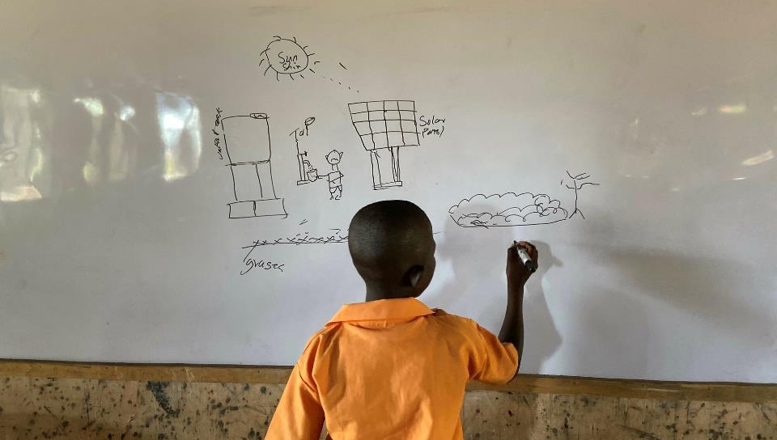
We work with people around the world who are making change happen
Notes:
Oxfam works with communities and organisations around the world who are taking action, supporting them with the things they need.
This is Lucas.* He lives in Ghana. Lucas would like to be a lawyer in the future. Climate change is causing the rainfall in Ghana to be more unpredictable. This is making it difficult for farmers to grow their crops.
The headmaster at Lucas’s school recently took the children to visit a nearby solar-powered water pump installed by Oxfam. The water from the pump helps farmers to grow vegetables during the dry season when there is little or no rain.
*Name changed
Credit: Kitty Norwell/Oxfam

Slide 21
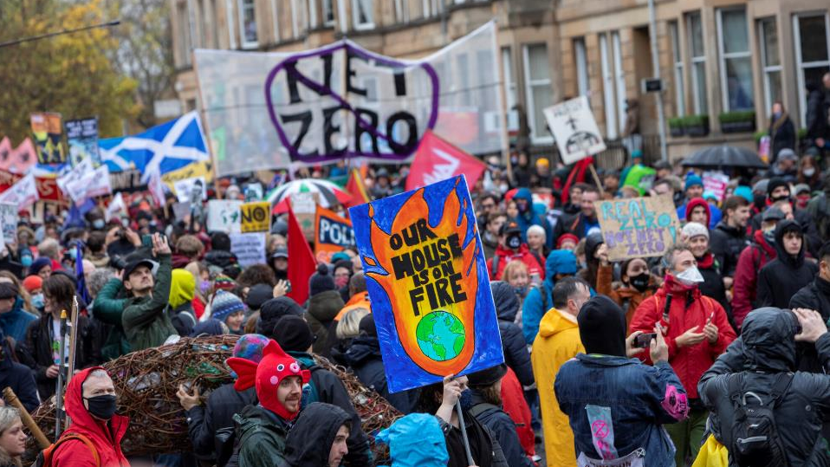
We are speaking out for a kinder, fairer and better world
Notes:
Oxfam is joining with others to call for more to be done to change the systems and structures that make it difficult for many people to access the things they need to thrive.
In November 2021, the eyes of the world were on the UK while the 26th United Nations Climate Change Conference (COP26) took place in Glasgow. Oxfam joined the Global Day of Action which saw thousands of other people marching for climate justice in cities and towns around the world, to ask world leaders to do more to tackle climate change.
Credit: Andy Aitchison/Oxfam

Slide 22
See, Think, Wonder
See: What can you see in the picture? What do you know for definite?
Think: What do you think is happening? Why do you think this? Why do you think Oxfam is doing this work? How do you think these activities are helping to create a kinder, fairer and better world?
Wonder: What do you wonder? What questions would you like to ask about the picture? What do you think people in the picture might be thinking or saying?

Slide 23
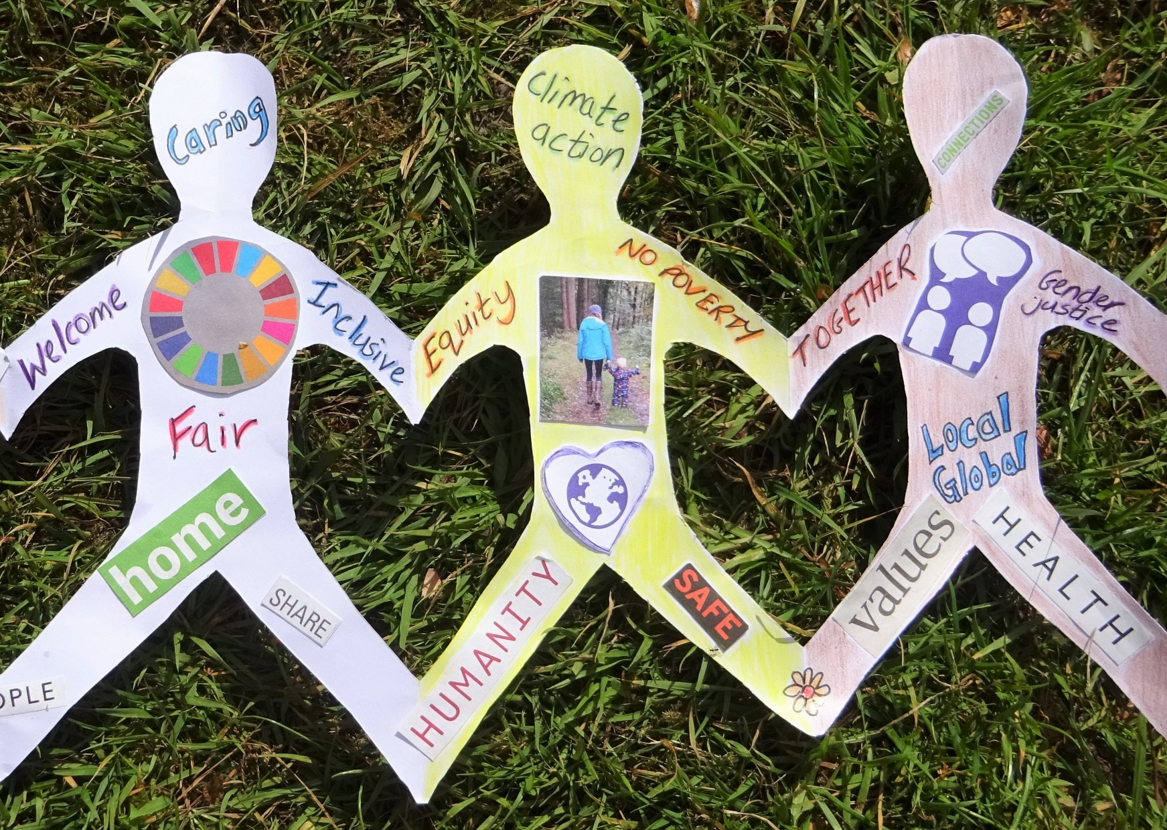
What do you think a kinder, fairer and better world would be like?

Slide 24
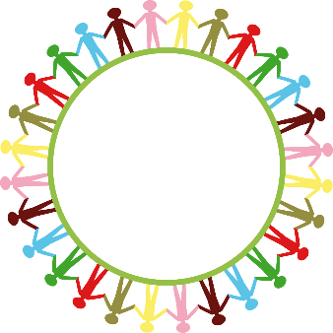
What could you do to help make
the world kinder, fairer and better?
At home?
In the place where you live?
At school?
Globally?
Notes:
Image: https://pixabay.com/vectors/globe-world-earth-hands-people-304586/

