Slide 1
The World Cup:
A fair game?
Use the World Cup to explore inequality
Notes:
This cross-curricular resource for 9-14 year olds uses the World Cup to engage learners critically with the question: Is the world a fair place? Through this engagement, they will think carefully about one key current global issue – inequality. Learners will compare statistics about the countries playing in the World Cup, including their FIFA rankings, average incomes, and levels of inequality. They will also explore gender inequality through the lens of football and think critically about why fewer women play football than men. Finally, learners will consider how fairness relates to rules, not just in making the game of football fair, but in our society in general.

Slide 2
English session
Why do fewer women than men play football?
Notes:
Learners will use an “agreement line” to consider their perceptions and attitudes about gender and sport. They will then work collaboratively in groups to read and sort information to solve a “mystery” about why fewer women play football than men. This activity will support learners to have a structured discussion around this issue, covering both the barriers facing women in football and the potential ways of overcoming them. Finally, learners will discuss other examples of gender inequality in our wider society, before reflecting on what changes they would like to see with regards to this issue in the future.

Slide 3
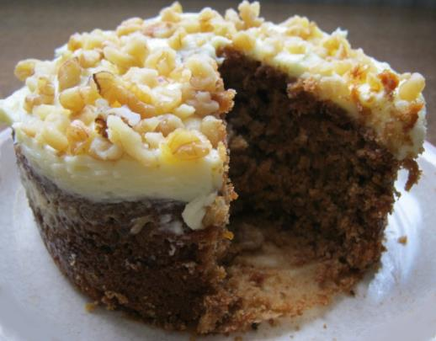
What is inequality?
We can think of inequality as the difference between the things some groups of people have compared to other people.
It is a bit like looking at how a big a slice of cake one person has compared to another.
Notes:
Photo credit: Liz Newbon/Oxfam

Slide 4
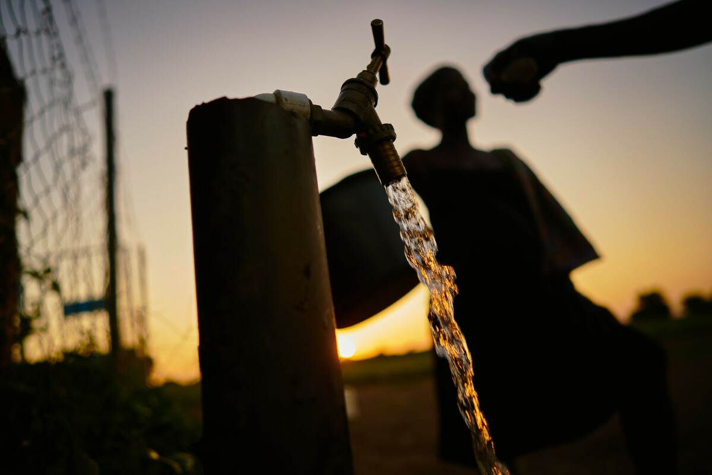
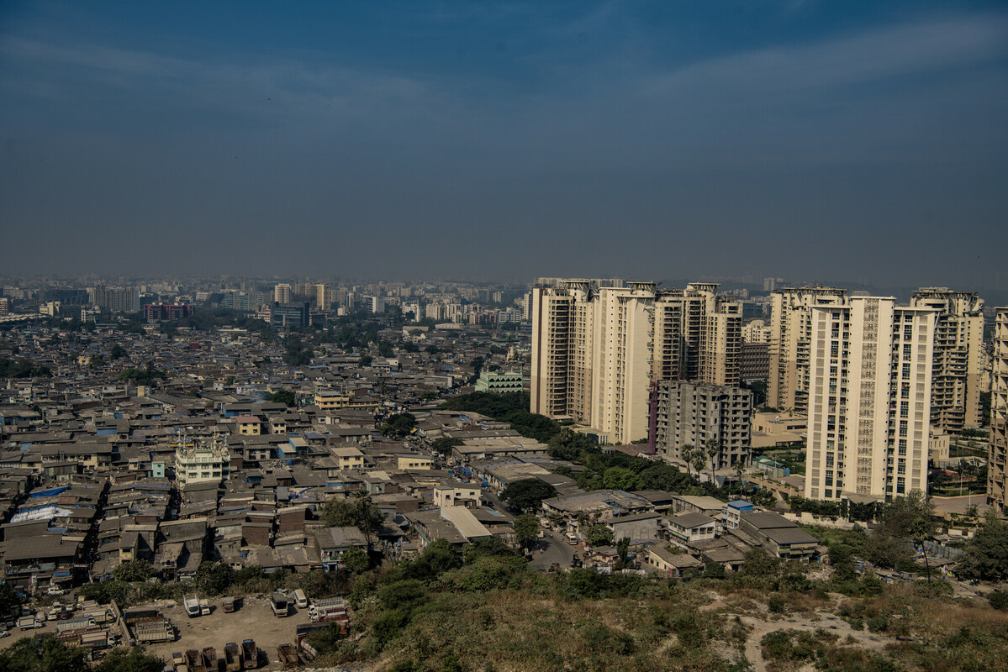
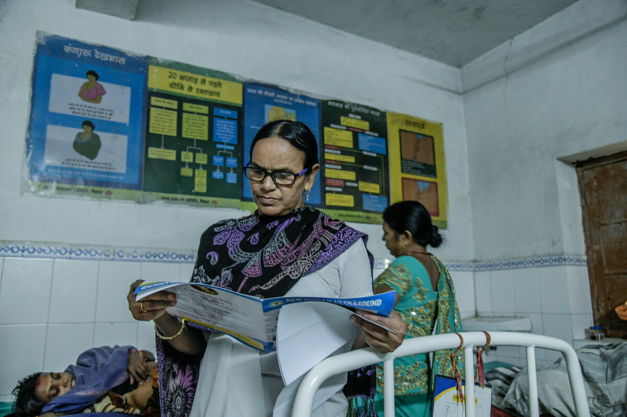
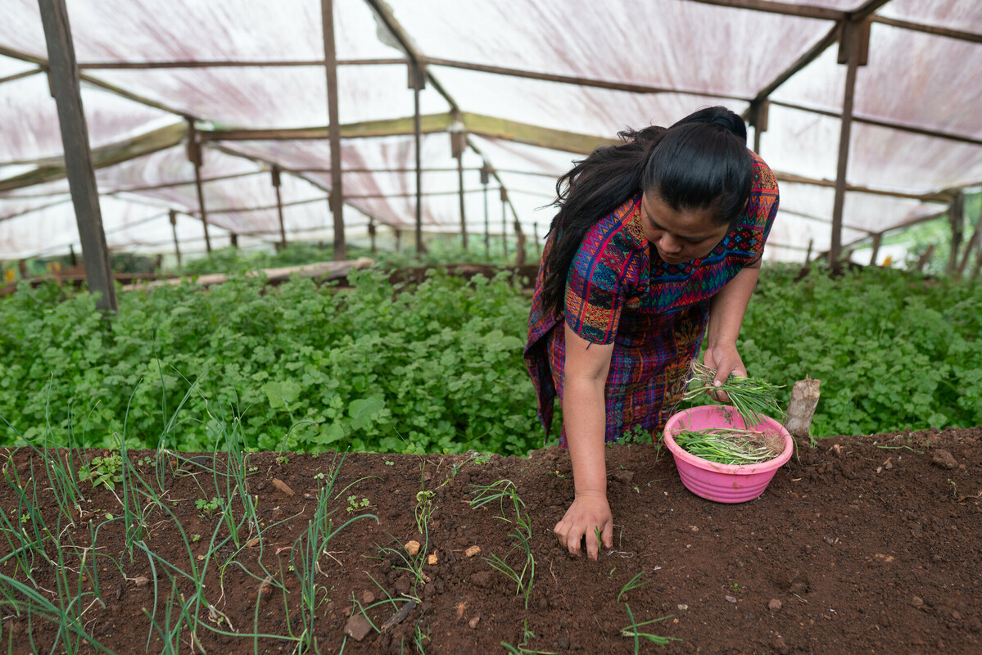
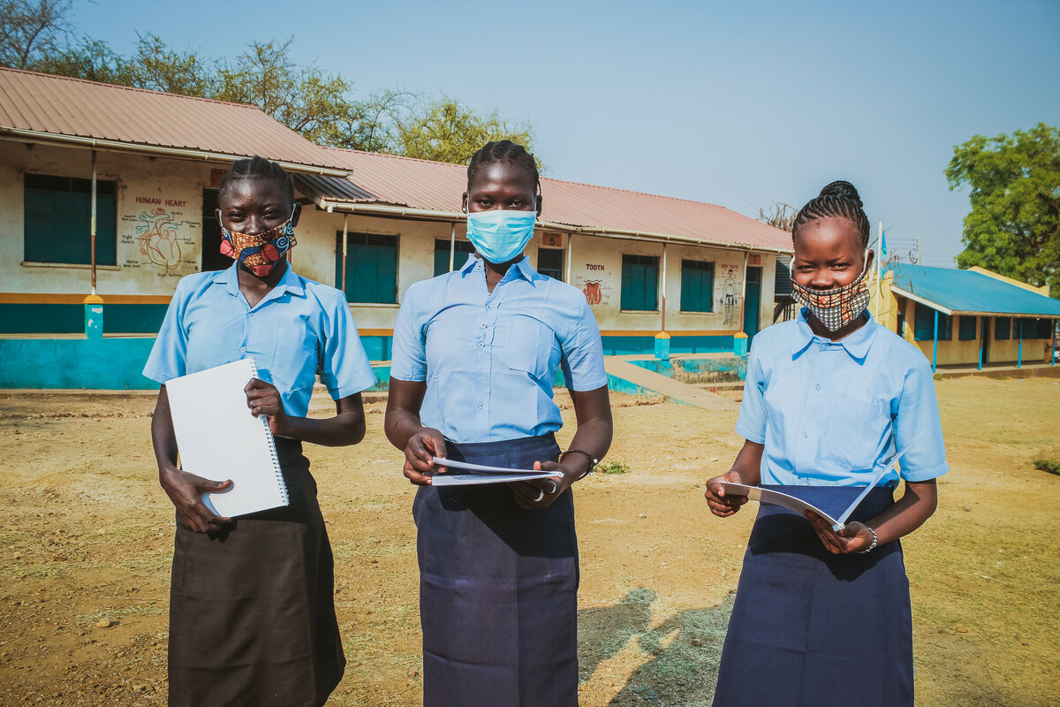
Thinking about inequality
Inequality is not just about how money is shared between and within countries.
There can also be inequality in the kinds of opportunities people have in life.
Notes:
Clockwise from top left.
Access to water
Image info: Ghana. Women fetch water at the Kpatua solar powered borehole during sunset.
Photo credit: Nana Kofi Acquah/Oxfam
Access to housing
Image info: A slum next to highrise residences for the upper middle class in the Chandivali area, in the western suburbs of Mumbai, India, which illustrates a common contrasting lifestyle in the city
Photo credit: Atul Loke, Panos/Oxfam
Access to health
Image info: India. Sumanchala, an Auxiliary Nurse and Midwife (ANM) at work in Phulwarishariff primary health clinic in Patna, Bihar state.
Photo credit: Atul Loke, Panos/Oxfam
Access to education
Image info: Graduate students Winnie, Viola and Lucia in front of their school in Juba, South Sudan. With Oxfam’s support, they have been able to return to school after the lockdown.
Photo credit: Mustafa Osman/Oxfam
Access to work and food
Image info: Guatemala. Brenda Guanche, 30, in the garden she shares with her sister in Chixim Hamlet. Her crops include onion, coriander, radishes, chard, and the aromatic herb epazote.
Photo credit: James Rodriguez/Oxfam

Slide 5
Gender inequality
What examples of inequality can you think of between men and women or girls and boys?
What do you think are the reasons for these inequalities?
♀♂

Slide 6
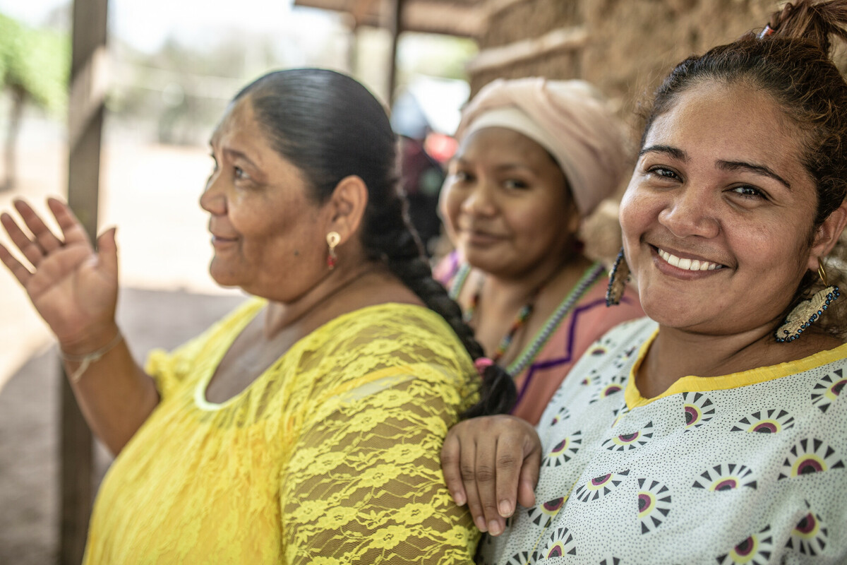
It’s only 100 years since some women in the UK got the vote, but today women in nearly every country in the world have the right to vote.
More women are in paid work.
More girls are going to school than ever before.
Laws are in place around the world to support gender equality.
Notes:
Image info: Colombia: Monica, Janet and Norka are members of the organization Fuerza de Mujeres Wayuu, defenders of human, territorial and environmental rights (translation from Spanish)
Photo credit: Pablo Tosco/Oxfam Intermón

Slide 7
Unequal opportunities
Women and girls make up the majority of those living in poverty.
Women are more likely than men to be in low-paid work. They earn less for doing the same roles and are often in the lower paid roles as well.
On average, women do twice as much unpaid care work as men, such as childcare and housework – sometimes 10 times as much, often on top of their paid work.
Only 23% of parliamentarians around the world are women.
Notes:
Sources:
F Rhodes, A Parvez and R Harvey (2017). An economy that works for women. Oxfam.
www.oxfam.org/en/research/economy-works-women
archive.ipu.org/wmn-e/world.htm

Slide 8
Ideal futures
Preferable future
Present
Probable future

