Slide 1
The World Cup:
A Fair Game?
Use the World Cup to explore inequality
Notes:
This cross-curricular resource for 9-14 year olds uses the World Cup to engage learners critically with the question: Is the world a fair place? Through this engagement, they will think carefully about one key current global issue – inequality. Learners will compare statistics about the countries playing in the World Cup, including their FIFA rankings, average incomes, and levels of inequality. They will also explore gender inequality through the lens of football and think critically about why fewer women play football than men. Finally, learners will consider how fairness relates to rules, not just in making the game of football fair, but in our society in general.

Slide 2
Geography session
Mapping the differences
Notes:
Learners will consider possible similarities and differences between countries participating in the 2022 World Cup. They will then use a World Cup Trumps game to investigate how average annual income per person, fairness score and FIFA ranking vary between these countries, before discussing the potential causes for any between-country inequalities. Finally, learners will shade in world maps to illustrate some of these differences between countries and discuss possible “football” and “non-football” reasons for why some countries have a greater chance of winning the World Cup than others.

Slide 3
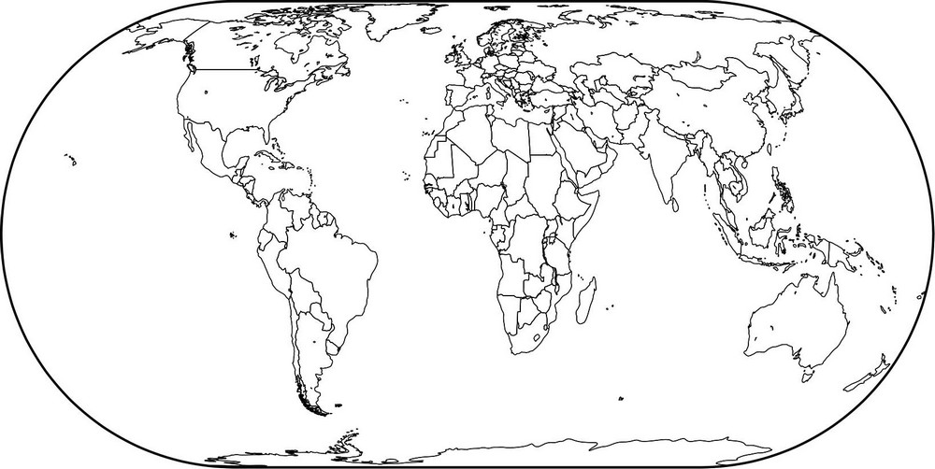
Where in the world?
UK
Viet Nam
Ethiopia
India
Peru
Can you locate the UK and Qatar on a world map?
Notes:
Click on the slide twice to reveal the locations of these countries.
Map source: Geographical Association www.geography.org.uk

Slide 4






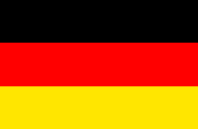
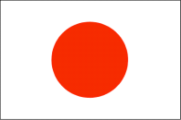





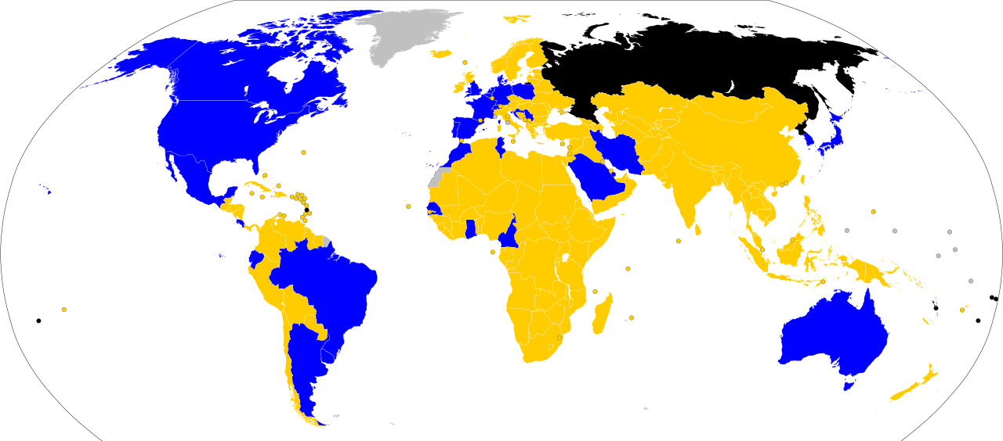









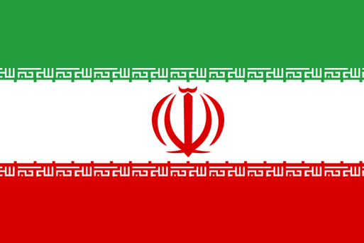







There are 32 countries taking part in the World Cup.
Notes:
Key
Blue: Teams qualified for World Cup
Gold: Teams failed to qualify for World Cup
Black: Teams expelled from the tournament by FIFA during the qualification period
Grey: Countries were not FIFA members
Image credit: CCO - File: 2022 world cup qualification.svg https://en.wikipedia.org/wiki/2022_FIFA_World_Cup#/media/File:2022_world_cup_qualification.svg
This file is made available under the Creative Commons CC0 1.0 Universal Public Domain Dedication

Slide 5
What links do we have with these countries?
What similarities do these countries have?
What differences are there between these countries?

Slide 6
Wales | Australia | Brazil | Belgium
Netherlands | Denmark | Costa Rica | England
Saudi Arabia | France | Serbia | Ecuador
Canada | USA | Switzerland | Tunisia
IR Iran | Argentina | Germany | Qatar
Morocco | Croatia | Mexico | Japan
Portugal | Uruguay | South Korea | Poland
Spain | Cameroon | Ghana | Senegal

Slide 7
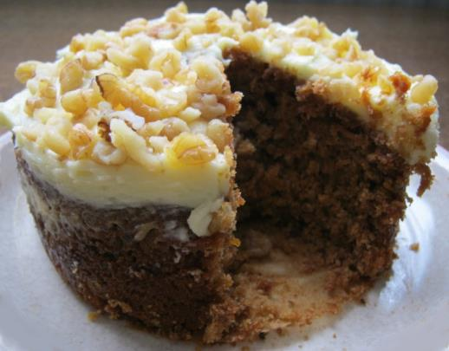
What is inequality?
We can think of inequality as the difference between the things some groups of people have compared to other people.
It is a bit like looking at how a big a slice of cake one person has compared to another.
Notes:
Photo credit: Liz Newbon/Oxfam

Slide 8


Inequality between countries
There is inequality between countries in the world.
This means things are not shared fairly between countries.
For example, some countries are wealthy while others are extremely poor.

Slide 9
Put these countries in order by their average annual income per person.
Ghana
Costa Rica
Ecuador
England
US$2,445
Lower-middle
US$12,509
Upper-middle
US$5,935
Upper-middle
US$47,334
High
Notes:
Data source: These figures are for GNI per capita, Atlas method (current US$), World Bank: data.worldbank.org/
Figures correct at the time of publication.
(We haven’t given comparative figures for UK£ due to volatile exchange rates during 2022. Teachers may use an online currency converter to provide an up to date comparison when they use the resource)

Slide 10

Inequality within countries
There is also inequality within countries.
This means things are not shared fairly within the same country.
For example, some people may have more money than others.

Slide 11


Scoring inequality within countries
Countries can be given a score (called the GINI index) to show how equal or unequal they are.
0
A score of 0 means that the country is completely equal, that everyone in that country has the same amount of money.
That would look something like this:
In reality, no country looks like this.

Slide 12

Scoring inequality within countries
A score of 100 means the country is completely unequal.
This would look something like this:
100
In reality, thankfully, no country looks like this either.

Slide 13
Plotting fairness scores
Plot the 4 countries on the scale below.
Which is fairest?
0 25 50 75 100
Completely
equal
Completely
unequal
Brazil
49
Belgium
27
Argentina
42
England
35

Slide 14
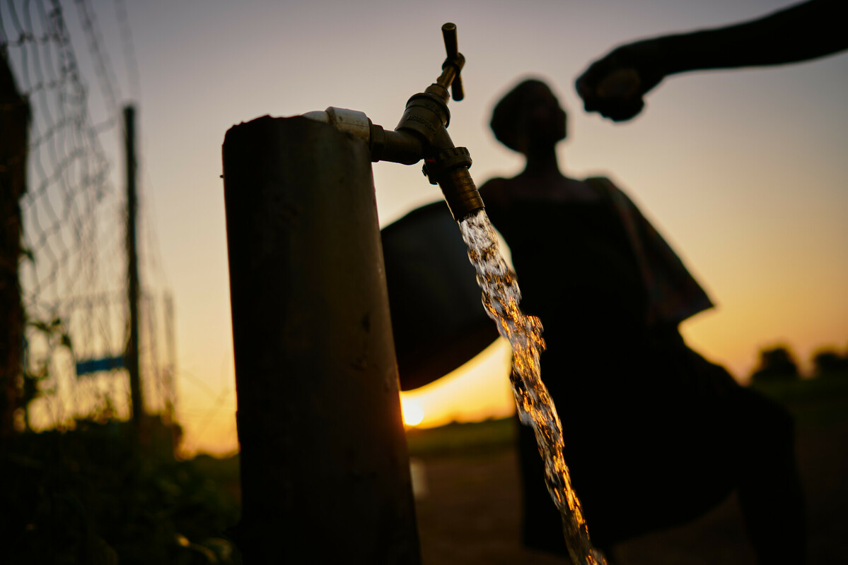
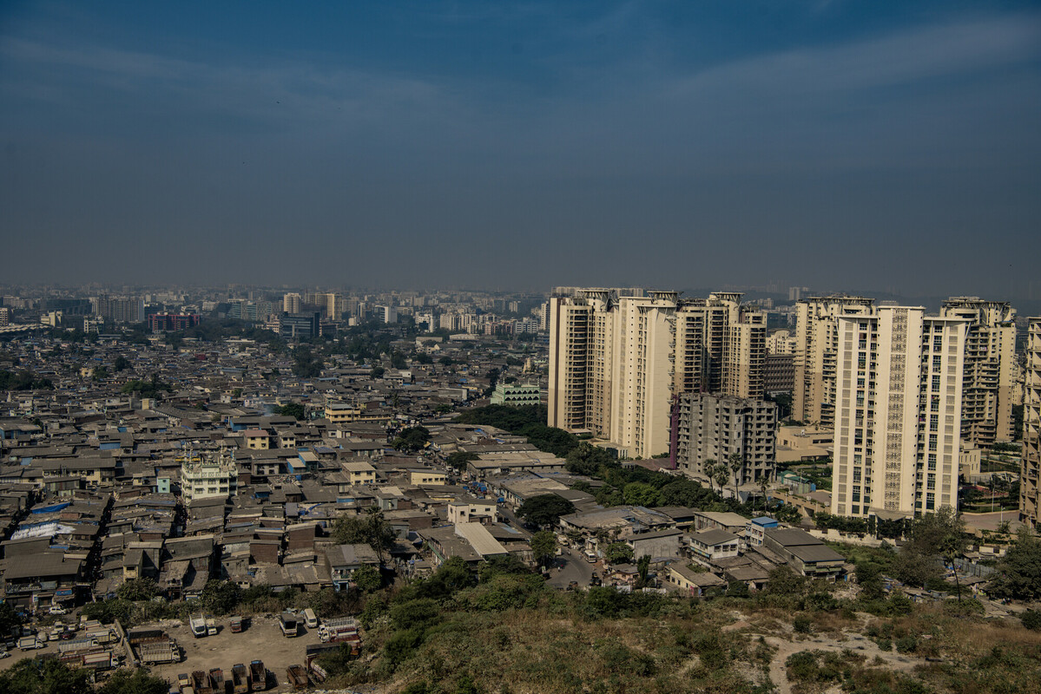
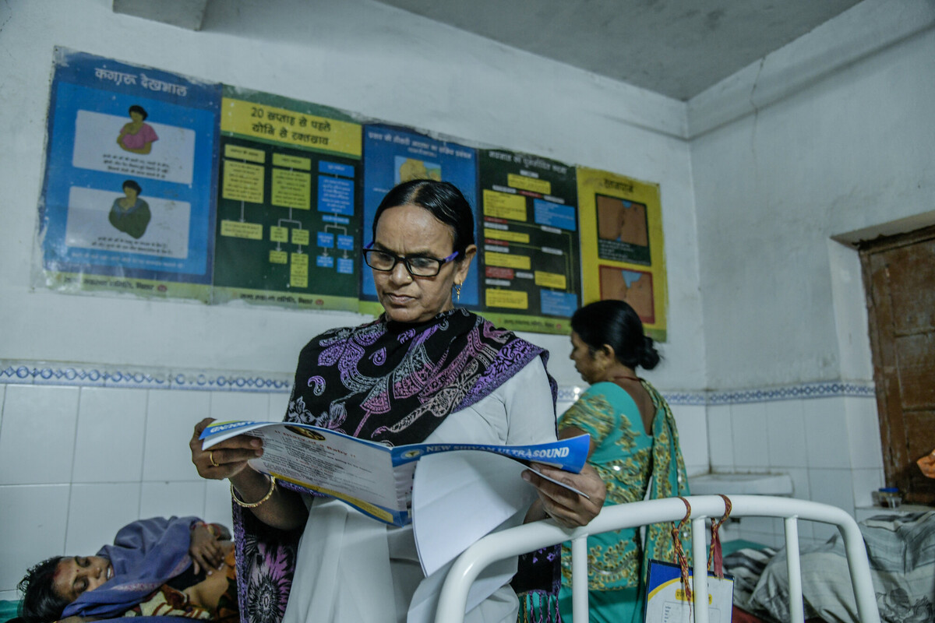
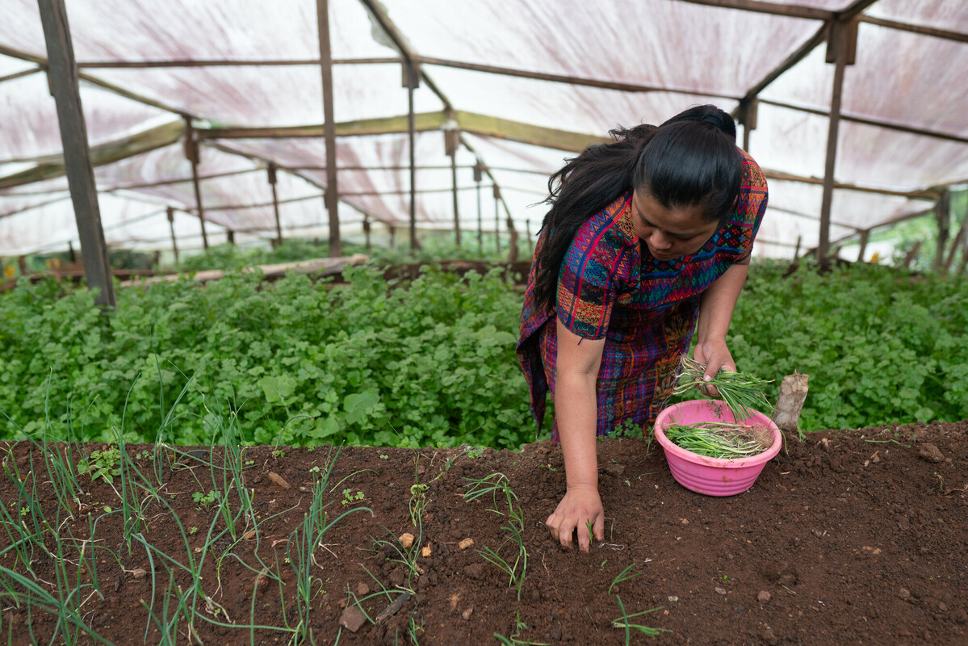
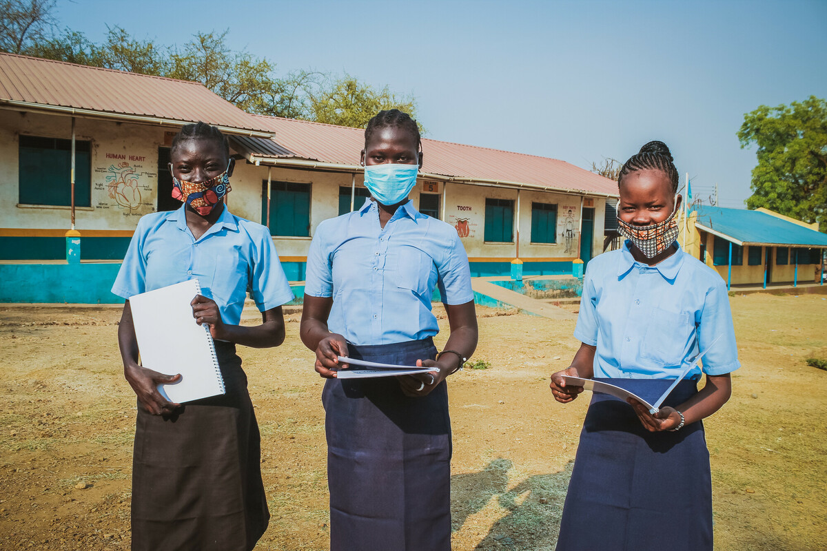
Thinking about inequality
Inequality is not just about how money is shared between and within countries.
There can also be inequality in the kinds of opportunities people have in life.
Notes:
Clockwise from top left.
Access to water
Image info: Ghana. Women fetch water at the Kpatua solar powered borehole during sunset.
Photo credit: Nana Kofi Acquah/Oxfam
Access to housing
Image info: A slum next to highrise residences for the upper middle class in the Chandivali area, in the western suburbs of Mumbai, India, which illustrates a common contrasting lifestyle in the city
Photo credit: Atul Loke, Panos/Oxfam
Access to health
Image info: India. Sumanchala, an Auxiliary Nurse and Midwife (ANM) at work in Phulwarishariff primary health clinic in Patna, Bihar state.
Photo credit: Atul Loke, Panos/Oxfam
Access to education
Image info: Graduate students Winnie, Viola and Lucia in front of their school in Juba, South Sudan. With Oxfam’s support, they have been able to return to school after the lockdown.
Photo credit: Mustafa Osman/Oxfam
Access to work and food
Image info: Guatemala. Brenda Guanche, 30, in the garden she shares with her sister in Chixim Hamlet. Her crops include onion, coriander, radishes, chard, and the aromatic herb epazote.
Photo credit: James Rodriguez/Oxfam

Slide 15
Do all teams have an equal chance of winning?
Why do some countries (or continents) have a greater chance of winning?
Are there any football reasons?
Are there any non-football reasons?
Notes:
Encourage learners to think about possible reasons related to football (such as having star players or a good manager) and reasons not directly connected with football (such as better education and healthcare or greater government investment in sports).

Slide 16
FIFA rankings
Group A | Group B | Group C | Group D | Group E | Group F | Group G | Group H
Qatar 48 | England 5 | Argentina 3 | France 4 | Spain 6 | Belgium 2 | Brazil 1 | Portugal 9
Ecuador 44 | IR Iran 22 | Saudi Arabia 53 | Australia 39 | Costa Rica 34 | Canada 43 | Serbia 25 | Ghana 60
Senegal 18 | USA 14 | Mexico 12 | Denmark 10 | Germany 11 | Morocco 23 | Switzerland 16 | Uruguay 13
Netherlands 8 | Wales 19 | Poland 26 | Tunisia 30 | Japan 24 | Croatia 15 | Cameroon 38 | South Korea 28
Notes:
Explain that FIFA ranks each team depending on how well they have performed in the past. These rankings suggest that the chances of success are not equal among teams/countries/continents.
Ask learners to make statements about how likely they think different teams are to win based on their ranking. For example:
It is highly likely that Brazil will win the 2022 World Cup.
It is highly unlikely that Ghana will win the 2022 World Cup.

Slide 17
Time to think
What differences do you notice between the countries?
Do any of the statistics surprise you? Which ones and why?
Do you notice any pattern between income and FIFA ranking? Why do you think this might be?

Slide 18
Questioning the data
Which country has the highest average income per person?
Which country has the lowest average income per person?
Which country is the most equal?
Which countries are the most unequal?
Which country has the greatest chance of winning the World Cup in 2022?
Which country is least likely to win the World Cup in 2022?
What is the difference in average income per person between Switzerland and Senegal?
Notes:
Answers
Switzerland ($93,457)
Senegal ($1,606)
Belgium (with a fairness score of 27)
Brazil and Costa Rica (with a fairness score of 49)
Brazil
Ghana
$91,851

Slide 19
Thinking about maps
Does anything about your map surprise you?
Where are the “richest” countries?
Where are the countries with the highest FIFA rankings?
What do you think might be the reasons for the differences between countries?
Do you think these inequalities are fair?

Slide 20
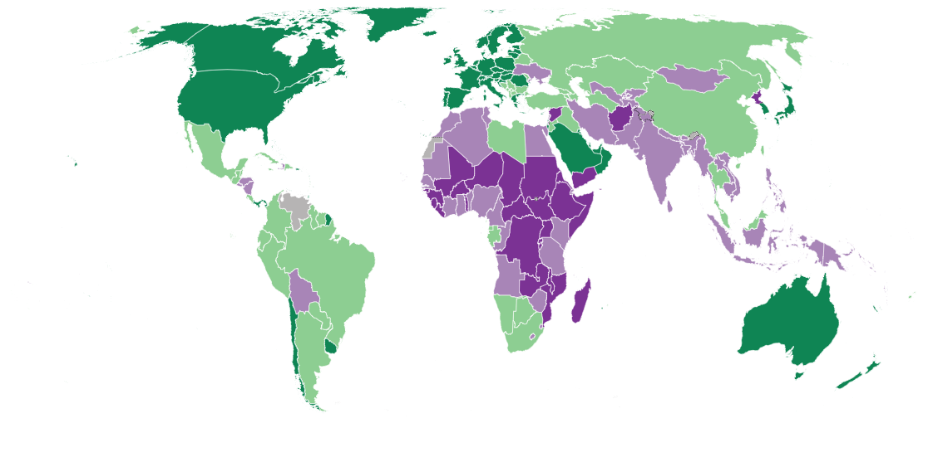
Average income per person
Key
Low income
Lower middle income
Upper middle income
High income
Notes:
This world map shows average annual income per person in different countries across the world. Countries with a lower average income are shaded in purples; those with a higher average income are shaded in greens.
Credit: World Bank, 2021. https://datatopics.worldbank.org/world-development-indicators/the-world-by-income-and-region.html

Slide 21
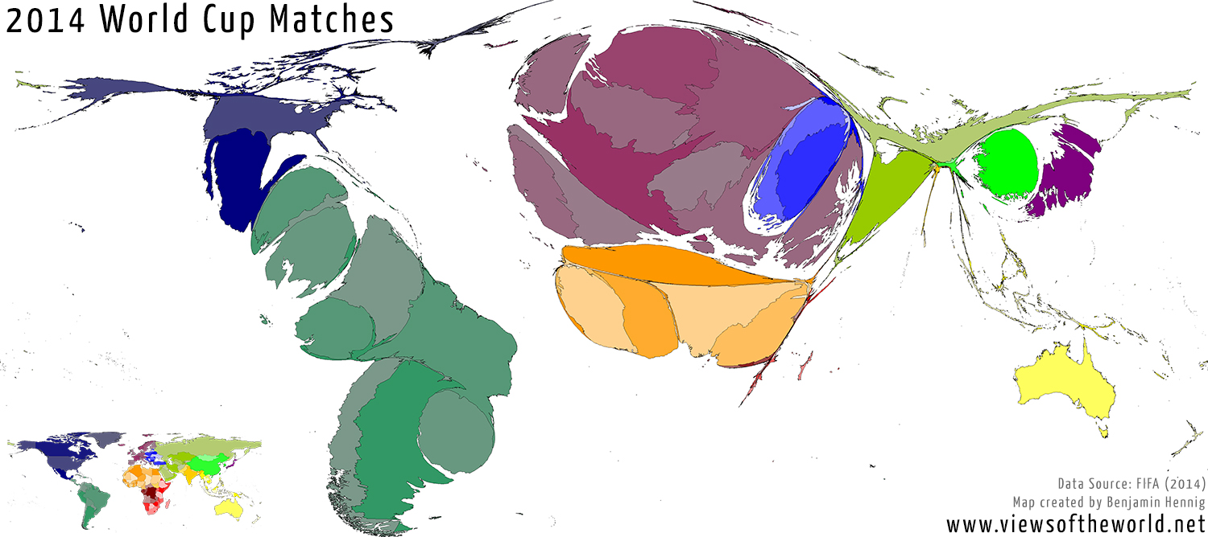
Notes:
This map shows how the world looks distorted according to the total number of matches countries played at the 2014 World Cup.
What do learners notice? Which countries/continents are involved in the most World Cup matches? Why do you think this is?
Credit: Worldmapper. worldmapper.org/

