Slide 1
The World Cup:
A fair game?
Use the World Cup to explore inequality
Notes:
This cross-curricular resource for 9-14 year olds uses the World Cup to engage learners critically with the question: Is the world a fair place? Through this engagement, they will think carefully about one key current global issue – inequality. Learners will compare statistics about the countries playing in the World Cup, including their FIFA rankings, average incomes, and levels of inequality. They will also explore gender inequality through the lens of football and think critically about why fewer women play football than men. Finally, learners will consider how fairness relates to rules, not just in making the game of football fair, but in our society in general.

Slide 2
Maths session
Equal or unequal?
Notes:
Learners will use fractions and the language of probability to describe the chances of different teams winning the 2022 World Cup. They will then discuss possible reasons why some teams are more likely to win than others, linking this not only to football but also to wider issues related to the resources available to a country. Next, learners will investigate whether the World Cup teams come from generally higher or lower-income countries. They will use fractions and percentages to compare the wealth (or income) of the World Cup countries, before using ratios to express these between-country income inequalities. In the final activity, learners will use “fairness scores” (GINI indices) to investigate how fair or equal individual countries playing in the World Cup are. Learners will compare and order the scores for different countries, before calculating the mean or average score. They will use their findings to consider whether the World Cup countries are generally equal or not.

Slide 3
Probability
True or false?
Ecuador is unlikely to win the World Cup.
England has a 1/32 chance of winning the World Cup.
A team from Africa has the same chance of winning the world cup as a team from Europe.
Does every team have the same chance of winning?
Notes:
Use these statements to introduce the idea of probability statements and fractions in relation to the World Cup.
Explain that learners will investigate data to help them answer questions like these during the session.
Answers
1 = True – This is based on the total number of countries taking part and Ecuador’s FIFA ranking.
2 = True – This is based only on the total number of countries taking part.
3 = False – This is based only on the numbers of teams who have qualified from Africa and Europe. There are 5 qualified teams from Africa but 13 teams from Europe have qualified. As learners will discover during the activity, other factors will also influence a team’s chances of success.

Slide 4







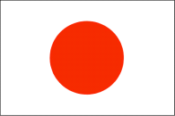





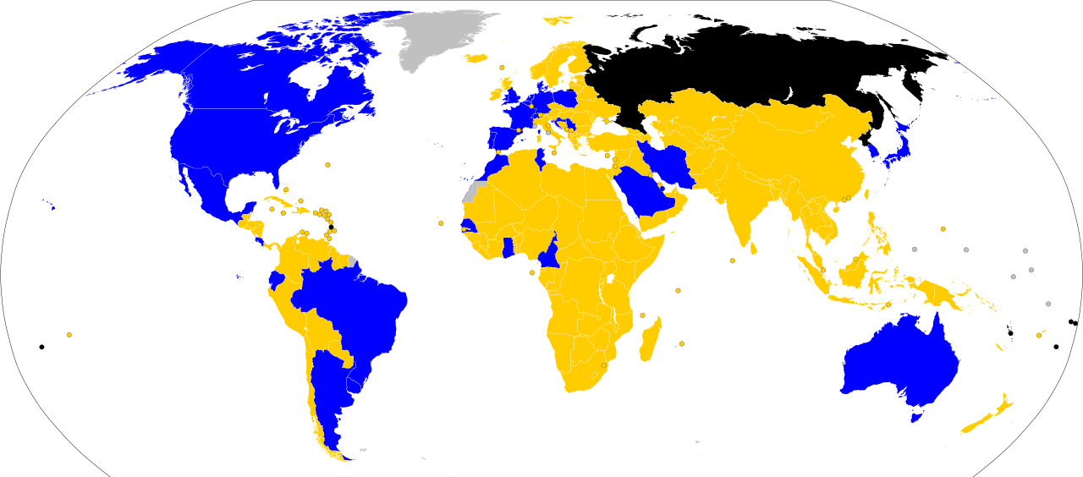

















There are 32 countries taking part in the World Cup.
Notes:
Key
Blue: Teams qualified for World Cup
Gold: Teams failed to qualify for World Cup
Black: Teams expelled from the tournament by FIFA during the qualification period
Grey: Countries were not FIFA members
Image credit: CCO - File: 2022 world cup qualification.svg https://en.wikipedia.org/wiki/2022_FIFA_World_Cup#/media/File:2022_world_cup_qualification.svg
This file is made available under the Creative Commons CC0 1.0 Universal Public Domain Dedication

Slide 5
Probability fractions
What is the probability of:
England winning the World Cup?
Russia winning the World Cup?
A team from Group A winning the World Cup?
England winning its group stage?
A country with the colour red used in its flag winning the World Cup?
Notes:
Ask learners to calculate the probability of:
England winning the World Cup? 1/32
Ecuador winning the World Cup? 1/32
A team from Group A winning the World Cup? 1/8
Note: You may need to first explain that FIFA organises the countries into eight groups of four for the tournament.
England winning its group stage? 1/4
A country with the colour blue used in its flag winning the World Cup? 3/8
Challenge learners to formulate their own questions or statements.

Slide 6
FIFA rankings
Group A | Group B | Group C | Group D | Group E | Group F | Group G | Group H
Qatar 48 | England 5 | Argentina 3 | France 4 | Spain 6 | Belgium 2 | Brazil 1 | Portugal 9
Ecuador 44 | IR Iran 22 | Saudi Arabia 53 | Australia 39 | Costa Rica 34 | Canada 43 | Serbia 25 | Ghana 60
Senegal 18 | USA 14 | Mexico 12 | Denmark 10 | Germany 11 | Morocco 23 | Switzerland 16 | Uruguay 13
Netherlands 8 | Wales 19 | Poland 26 | Tunisia 30 | Japan 24 | Croatia 15 | Cameroon 38 | South Korea 28
Notes:
Explain that the chances of winning are not as simple as finding a fraction. FIFA ranks each team depending on how well it has performed in the past.

Slide 7
Probability statements
Less likely
More likely
Certain
Impossible
Highly unlikely
Unlikely
Even chance
Likely
Highly likely
………........ is more/less likely to win the World Cup than ………........ because ........................
A team from Group .... is more/less likely to win the World Cup than a team from Group .... because ........................
A team from Europe is more/less likely to win the World Cup than a team from Africa because ........................
Notes:
Ask learners to use the FIFA rankings to make statements about how likely they think different teams are to win based on their rankings. They can look at individual teams, groups, or teams from different continents.
Note: There are more European teams in the World Cup as FIFA allocates them more places – this makes it statistically more likely that a team from Europe will win the World Cup than one from another continent. However the FIFA rankings also show that teams from Europe have higher rankings than teams from Africa and Asia. This means that it is more likely that a team from Europe will win, both because there are more teams from Europe and because these teams have higher FIFA rankings.

Slide 8
Why isn’t it equal?
Why do some teams have a greater chance of winning?
Why do teams from some continents have a greater chance of winning?
Are there any football reasons?
Are there any non-football reasons?
Notes:
Draw out that the FIFA rankings show that certain countries, or teams from certain continents, have a better chance of winning than others. Ask learners why they think this might be. Encourage them to think about possible reasons related to football (such as having star players or a good manager) and reasons not directly connected with football (such as better education and healthcare or greater government investment in sports).

Slide 9



Reasons for teams being more/less likely to win the World Cup…
How much is this related to things outside of football itself? Is this fair?
Notes:
Explore this question in more depth by repeatedly asking the question “Why?”.
An example:
Why are some teams less likely to win the World Cup?
Because some teams are not as good.
Why are some teams not as good?
Some teams are not as good because they don’t train as much.
Why don’t some teams train as much?
Because some teams don’t have a lot of money in their country to spend on football.
Why don’t some countries have as much money?
And so on…
Encourage learners to consider if it is fair that some countries seem to have a better chance than others for reasons that have nothing to do with football. Explain that they will explore this in more detail in the next activity.

Slide 10


Country incomes
The World Bank classifies each country as one of the following:
a low-income country
a lower-middle-income country
an upper-middle-income country
a high-income country
Which group do you think each of these countries is in?
Costa Rica
England
Senegal
Upper-middle High Lower-middle
Notes:
Average annual income per person: Costa Rica (US$12,509), England (figures are for the UK) (US$47,334), Senegal (US$1,606)
No Low-income countries qualified for the 2022 World Cup. Why might this be?
Data source: These figures are for GDP per capita, (current US$), World Bank: https://data.worldbank.org/indicator/NY.GDP.PCAP.CD
Figures correct at the time of publication.
Exchange rates for £s have not been given because of the volatile exchange rates in 2022. They may be calculated using an online currency converter.

Slide 11








58,061 | 3,497 | 5,935 | 1,606
47,334 | 7,519 | 34,758 | 23,586
17,841 | 47,334 | 24,262 | 3,390
5,310 | 27,580 | 54,770 | 93,457
69,934 | 12,509 | 1,662 | 10,729
2,445 | 17,021 | 50,802 | 39,285
51,768 | 17,399 | 67,803 | 61,276
9,926 | 43,518 | 69,287 | 2,757
Notes:
Explain that this data shows the annual average income per person (in US$) for the 32 countries taking part in the 2022 World Cup.
Discuss the data with learners. Possible questions include:
What is the highest average income per person? Which country do you think this is?
Answer: Switzerland (US$93,457)
What is the lowest average income per person? Which country do you think this is?
Answer: Senegal (US$1,606)
Which do you think is the average income per person for England?
Answer: US$47,337
Which do you think is the average income per person for Brazil?
Answer: US$7,519
Are you surprised by this data? If so, why?

Slide 12
Inequality
Is there a big difference between the countries’ incomes?
This difference is called income inequality.
Inequality means the difference in resources or opportunities for one group of people versus another.

Slide 13
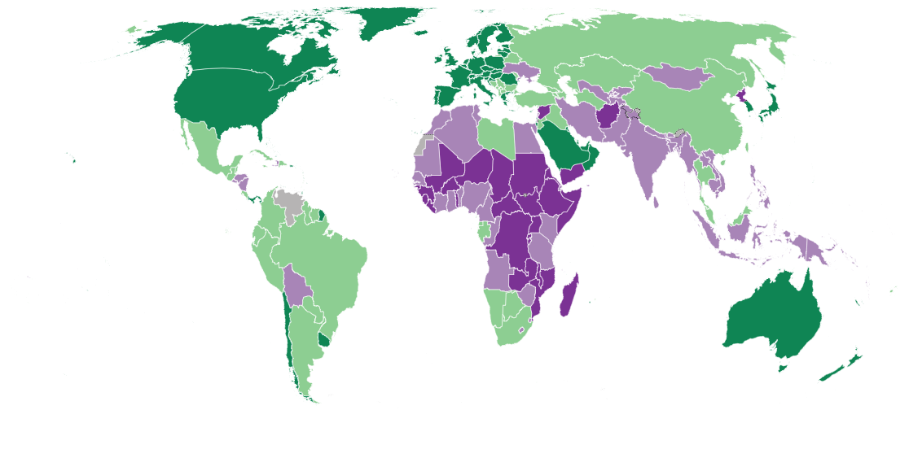
Average income per person
Key
Low income
Lower middle income
Upper middle income
High income
Notes:
This world map shows average annual income per person in different countries across the world. Countries with a lower average income are shaded in purples; those with a higher average income are shaded in greens.
Credit: World Bank, 2021. https://datatopics.worldbank.org/world-development-indicators/the-world-by-income-and-region.html

Slide 14
Why?
Think about how having extra income could affect football teams:
Directly – for example by providing better resources for training.
And indirectly – for example by providing better healthcare and education for children.
Notes:
Ask learners to consider about how a country’s income or wealth can affect football both directly and indirectly.

Slide 15
Statements and generalisations
Wealthy countries are…
The more money a country has…
Income inequality in the World Cup is…
Most…
European countries…
Notes:
Use these sentence starters to make statements based on the evidence about these World Cup countries.

Slide 16
Is this fair?
Choose a team to support through the tournament.
Will you choose a high-, higher middle- or lower middle-income country? Why?
If a high-income country has more money to invest in football, what else would it have more money to invest in?
Is football fair?
Would you prefer to grow up in a high-, higher middle- or lower middle- income country? Why?
If a low-income country has less money to invest in football, what else would it have less money to invest in?
Notes:
Use these questions to prompt discussion.

Slide 17

Inequality between countries
There is inequality between countries in the world.
This means things are not shared fairly between countries.
For example, some countries are wealthy while others are extremely poor.

Slide 18

Inequality within countries
There is also inequality within countries.
This means things are not shared fairly within the same country.
For example, some people may have more money than others.

Slide 19

Notes:
Source: S. Dransfield (2014). A Tale of Two Britains: Inequality in the UK. Oxfam.
policy-practice.oxfam.org.uk/publications/a-tale-of-two-britains-inequality-in-the-uk-314152

Slide 20


Scoring inequality within countries
Countries can be given a score (called the GINI index) to show how equal or unequal they are.
0
A score of 0 means that the country is completely equal, that everyone in that country has the same amount of money.
That would look something like this:
In reality, no country looks like this.

Slide 21

Scoring inequality within countries
A score of 100 means the country is completely unequal.
This would look something like this:
100
In reality, thankfully, no country looks like this either.

Slide 22
Plotting fairness scores
Plot the 4 countries on the scale below.
0 25 50 75 100
Completely
equal
Completely
unequal
Brazil
49
Belgium
27
Uruguay
40
England
35
Notes:
Which country is fairest?

