Slide 1
The World Cup:
A fair game?
Use the World Cup to explore inequality
Notes:
This cross-curricular resource for 9-14 year olds uses the World Cup to engage learners critically with the question: Is the world a fair place? Through this engagement, they will think carefully about one key current global issue – inequality. Learners will compare statistics about the countries playing in the World Cup, including their FIFA rankings, average incomes, and levels of inequality. They will also explore gender inequality through the lens of football and think critically about why fewer women play football than men. Finally, learners will consider how fairness relates to rules, not just in making the game of football fair, but in our society in general.

Slide 2
PE session
Making the game fairer for all
Notes:
Learners will use the context of football to think about how fairness relates to rules. They will consider not only how rules are used to make the game of football “fair”, but also think about why some people have easier access to playing football than others. Learners will explore how they could use rules to make the game more inclusive, before coming up with their own rules for a “Fair” football tournament where everyone is able to take part. This will prompt learners to think about how rules in society can make life fairer for everyone.

Slide 3
Rules
Why do we have rules?
How do rules make the game of football fairer?
How do rules make school fairer?
How do rules make the world fairer?
Rule Book

Slide 4
Are the same rules always “fair”?
Yes
No
What about for people of…
Different ages?
Different abilities?
Different genders?
Particular needs?
Different backgrounds?

Slide 5
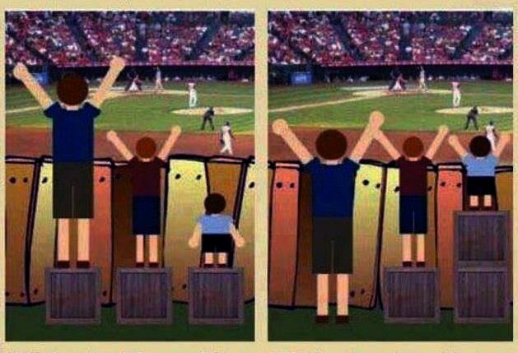
Treated equally
Treated equitably
Which do you think is fairer?
Notes:
Explain that equality aims to make things fair by giving everyone the things they need to enjoy good, healthy lives. However this only works if everyone starts from the same place and needs the same things. Fairness is about trying to understand what different people need in order to enjoy good, healthy lives. For example, in school, younger children may get extra playtime or go to lunch earlier whereas older children may have more responsibilities around the school. Ask learners to think of other examples.
Image info: Please note that the image source is unknown despite attempts to identify it.

Slide 6
Example 1
You want to have a football game but some of the players are 11 years old and others are aged 16.
What rule would you use to make the game fair?
Allow two points for…
Only let teams enter a competition if…
Give…
Show someone the red card if…
Limit match time to…
Ask some players to…

Slide 7
Example 1
You want to have a football game but some of the players are 11 years old and others are aged 16.
Did the rule you made to solve this problem make the game fairer for:
A few players?
Some players?
Most players?
All players?

Slide 8
Example 2
You meet some young people from another country who have never played football before, but you want to play them at football.
What rule would you use to make the game fair?
Allow two points for…
Only let teams enter a competition if…
Give…
Show someone the red card if…
Limit match time to…
Organise extra training for…

Slide 9
Example 2
You meet some young people from another country who have never played football before, but you want to play them at football.
Did the rule you made to solve this problem make the game fairer for:
A few players?
Some players?
Most players?
All players?

Slide 10
Example 3
Some players in your team are not coming to football practice because they cannot afford to buy the team kit.
What rule would you use to address this problem?
Allow two points for…
Only let teams enter a competition if…
Give…
Show someone the red card if…
Limit match time to…
Ask some players to…

Slide 11
Example 3
Some players in your team are not coming to football practice because they cannot afford to buy the team kit.
Did the rule you made to solve this problem make the game fairer for:
A few players?
Some players?
Most players?
All players?

Slide 12
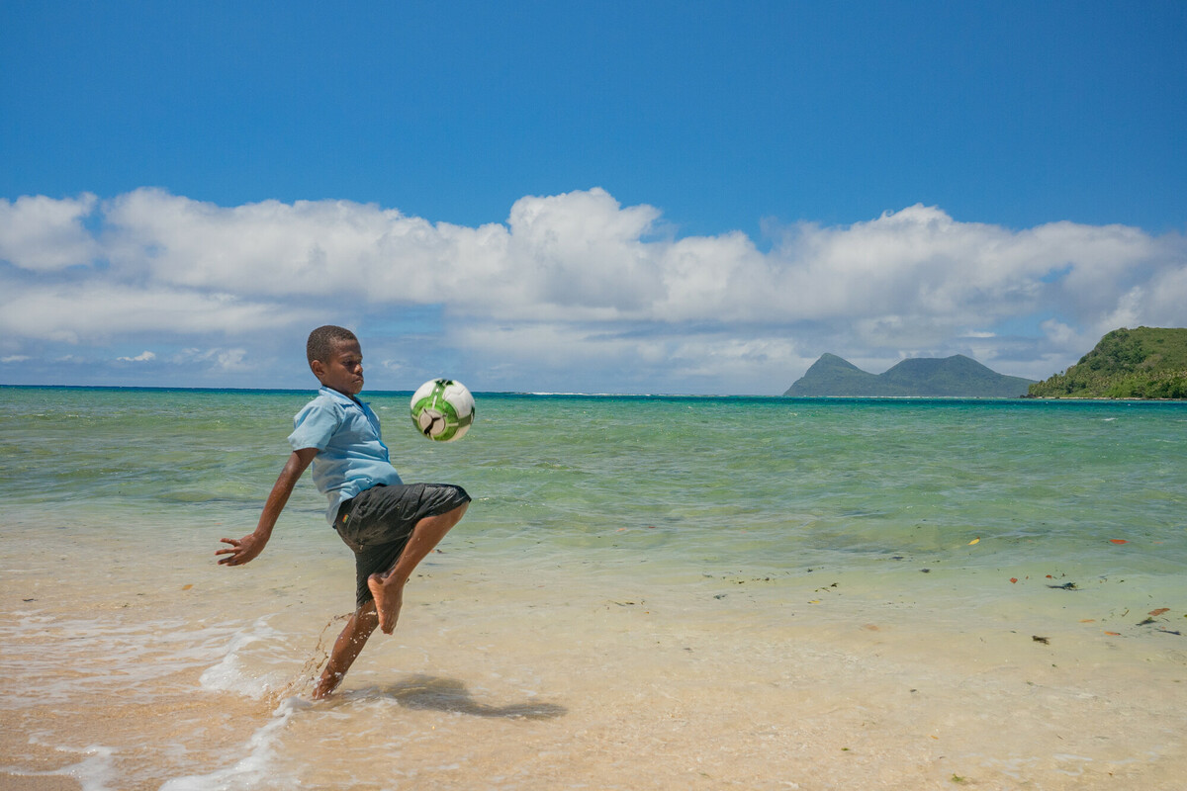
Making it fair
Are there any other examples of where using the “normal” rules of football might not allow everyone to take part equally.
Think
Pair
Share
Notes:
Think: Ask learners to think about the question on their own for a minute.
Pair: Give learners a couple of minutes to compare their ideas with a partner.
Share: Spend a few minutes sharing thoughts and reflections as a whole group.
Image info: Sea-level rise: a boy in Vanuatu juggles a ball where there was once a playing field. “We used to play football here,” says a community member.
Photo credit: Elizabeth Stevens/Oxfam America

Slide 13
A “fair” football tournament
You are going to organise a football tournament in which everyone in your class/year/school is going to take part.
However, you need to make sure it is completely fair for everyone to be able to fully participate.
How can you design the rules to help?

Slide 14
Your teams
All the people taking part will be organised into teams.
Each team could represent one of the countries taking part in the 2022 World Cup.
Each team will need to come up with a motto for the tournament. You could use words such as “every” and “all” in your motto.

Slide 15
Our tournament rules:
Our team motto:

Slide 16
Looking back
How did your tournament go?
Was your tournament “fair”? How?
Was everyone able to participate?
Did people enjoy it? Why? / Why not?
Do you need to change rules sometimes to make things “fairer”?
What have you learned through organising this event and taking part?

Slide 17
Is our world fair?
How about life generally? What rules are there to make it fairer?
Who sets the rules?
If there are unfair things in life, how can rules be used to change them?

Slide 18
Do we need rules to help make our world fairer?
Yes
No
We need… because…
We don’t need… because…
The types of rules we need are…

Slide 19
Example
People pay tax to pay for services such as schools and hospitals.
Should everyone pay the same amount of tax?
Or should people with less money pay less tax?

Slide 20
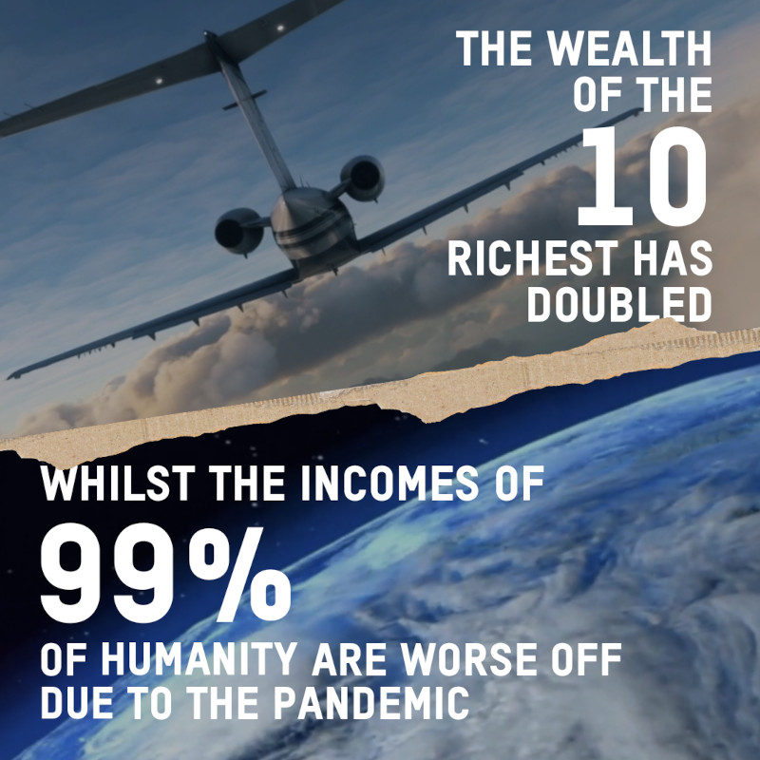
Notes:
Source: Alex Maitland (2022) – ‘None of us expected such a jump in wealth…. The inside story of how Oxfam’s analysts counted the billions’ https://views-voices.oxfam.org.uk/2022/01/none-of-us-expected-such-a-jump-in-wealth-the-inside-story-of-how-oxfams-analysts-counted-the-billions/

Slide 21
What would help to make our world a fairer place?

