Slide 1
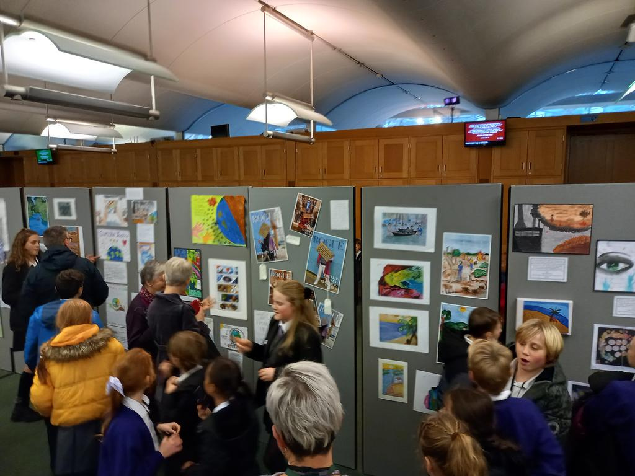






Get Creative for Climate Justice
Creative for the Climate exhibition in the Houses of Parliament. December 2023
Photo: Rebekah Lucking/Send My Friend to School
Notes:
Slide 1 - Creative for the Climate
This presentation introduces the Get Greative for Climate Justice project and how young people can work together, be creative and influence decision-makers, such as MPs, to do more to build a better and fairer world where there is climate justice for all.
It introduces a project where young people have their say about climate justice and are heard by MPs and government ministers. It then explains the 3 main ideas behind climate justice to help young people begin thinking about their art or creative writing.

Slide 2
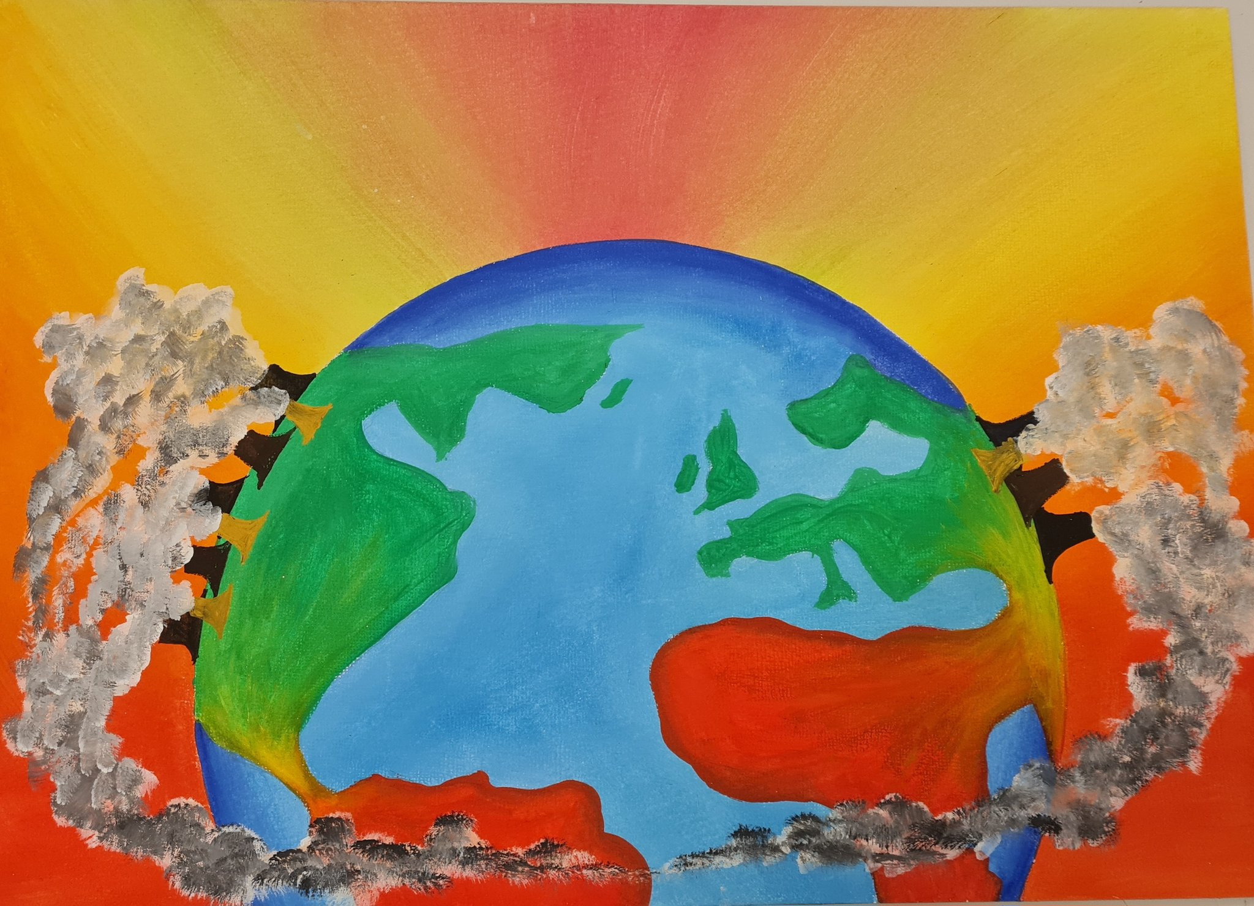
Artwork for Get Creative for Climate Justice 2023
Courtesy of Lawnswood School, Leeds
Notes:
Slide 2 - The Power of Your Creativity
Creativity - whether art or literature - is a powerful way for people to get their messages across and be heard. Throughout history artists and writers have used their creativity to influence leaders and the public alike.
Early in 2025 we're holding the Creative for the Climate exhibition in the Houses of Parliament and inviting MPs to come and visit. The exhibition will feature both art and creative writing.
This is one of the art exhibits from last year's exhibition. It creates a vey clever and persuasive message about climate justice.
What point do you think the artist is making? What do you think they are saying to MPs about climate justice?
(Note to teachers: Every country is unequal and has people who have either higher carbon emissions or lower carbon emissions. However overall the wealthy countries of the Global North - eg: the countries of North America and Europe - are making the largest carbon emissions. These emissions are having the greatest impact on the countries of the Global South - eg: the countries of Africa, Asia and South America - which are rapidly warming. This is unjust. The peoples of the Global South have done little to cause the climate challenges they are now facing)
Please use your full imagination and creativity in this project. We simply ask that your work is respectful and inclusive, and that you would feel proud to have it seen by MPs.
Before you begin, the next slides explain the three big solutions to climate injustice. The good news is that we know what many of these solutions are already. But we still have to persuade decision makers to ensure they are implemented.
Please think carefully and critically about these and do your own research. How you represent these ideas in your art and creative writing is your decision. We look forwards to seeing it.

Slide 3
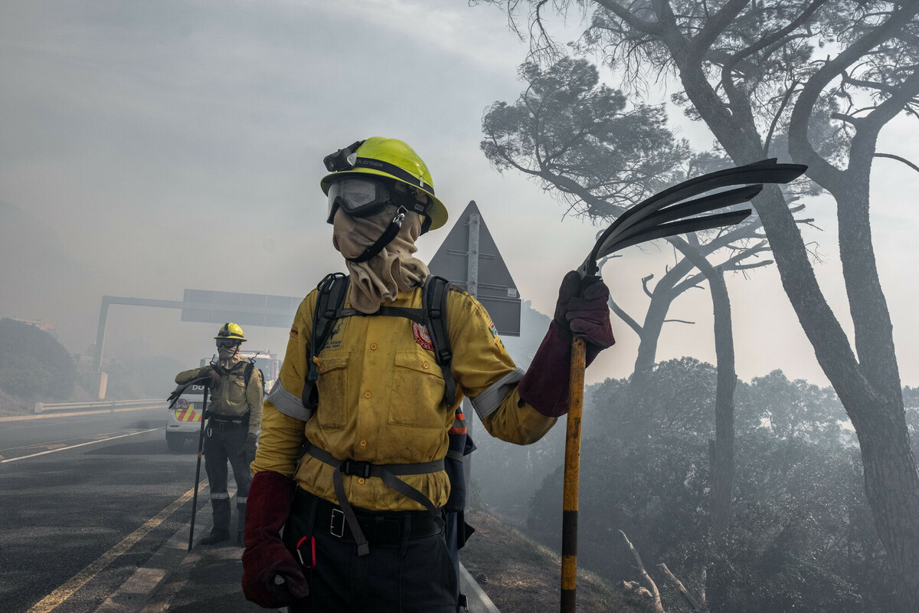

1 Reduce Emissions
Firefighters battle a wildfire
Cape Town, South Africa. April 2021
Photo: Tommy Trenchard/Oxfam
Funded by the European Union
Notes:
Slide 3 - Reduce Emissions
Since the Industrial Revolution began in England around 1800, some countries - for example in North America and Europe - have become wealthy by burning fossil fuels (coal, oil, gas). In the the 21st century other countries - for example China and India - have also become wealthier by burning fossil fuels. Burning fossil fuels emits greenhouse gases and this has increased the world's temperature by about 1.1C since 1800.
This may not sound much, but scientists warn that the safe limit for this temperature increase is 1.5C.
Therefore the first step towards climate justice is for countries to reduce their greenhouse gas emissions and keep the global temperature increase lower than 1.5C. Agreeing how to do this has proven difficult. At the COP26 climate change conference held in Glasgow in 2021, the plans which countries submitted would have led to global heating of 2.4C, well above the 1.5C limit.
This issue is made more complicated by the fact that countries have not emitted equal amounts of greenhouse gases. Some countries - like the UK in the Global North - have been burning fossil fuels in large quantities for a long time, while other countries - like Malawi in the Global South - haven't yet begun to make significant emissions.
Although the people living in every country emit different amounts of personal greenhouse gases, there is usually a connection between burning fossil fuels and a country's overall wealth. And although differences exist in every country and continent, the wealthy countries that have been burning the largest quantities of fossil fuels for the longest time usually haven't yet been affected by climate change as severely as the less wealthy countries who haven't.
This is an injustice. A fairer future would see wealthy countries reduce their carbon emissions fastest, fairly and first. But agreeing how and when to do this has not yet been possible.
Think about how you could represent these ideas in your art or creative writing.
The photo shows firefighters battling a wildfire just outside Cape Town, South Africa, in April 2021. Despite being a country of the Global South, South Africa still relies heavily on coal for energy and has high greenhouse gas emissions.

Slide 4
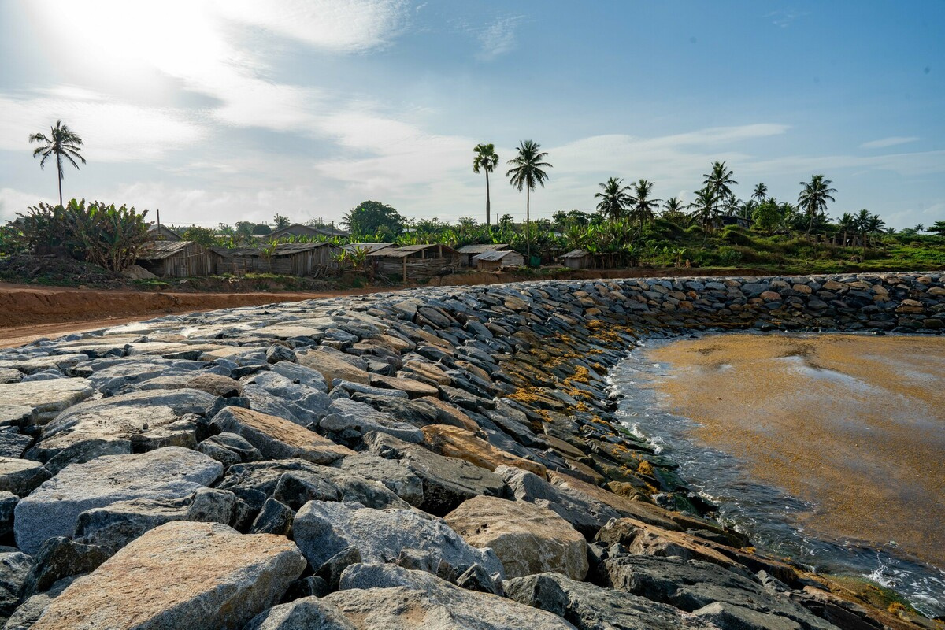
2 Climate Finance
Axim sea defence wall, Ghana, West Africa. May 2021
Photo: Nana Kofi Acquah/Oxfam
Funded by the European Union
Notes:
Slide 4 - Climate Finance
Even limiting global heating to 1.5C will still change the earth's climate forever. Everywhere people will have to make changes and live with a new climate.
For example, in the UK millions of homes will have to be insulated to control their temperatures and reduce energy use.
In the countries of the Global South, where the impacts of climate change are greatest, adapting to the new climate is even more urgent. However, these countries often don't have sufficient money to invest in adapting to climate change.
At the COP climate change conference in 2009 the wealthy countries agreed to provide $100 billion per year to help the countries of the Global South to adapt.
This 'climate finance' has been slow to be paid. Now that we are in 2024, the figure of $100 billion is out of date and no longer enough. A recent report estimates it should now be $300 billion.
The photo shows work on a protective sea wall in Axim in Ghana, West Africa. Rising sea levels caused by global warming are a threat all along the West African coast. In Axim the rising sea will flood communities and destroy the fishing industry unless sea defences are built. Building these defences will protect the local community and help them adapt to the new climate.
Climate justice recognises that the countries who have primarily caused the climate crisis have a responsibility pay the most for helping the most affected countries adapt. This help is arriving, but so far it has fallen short of what is needed.
Think how you could represent this idea in your art or creative writing.

Slide 5
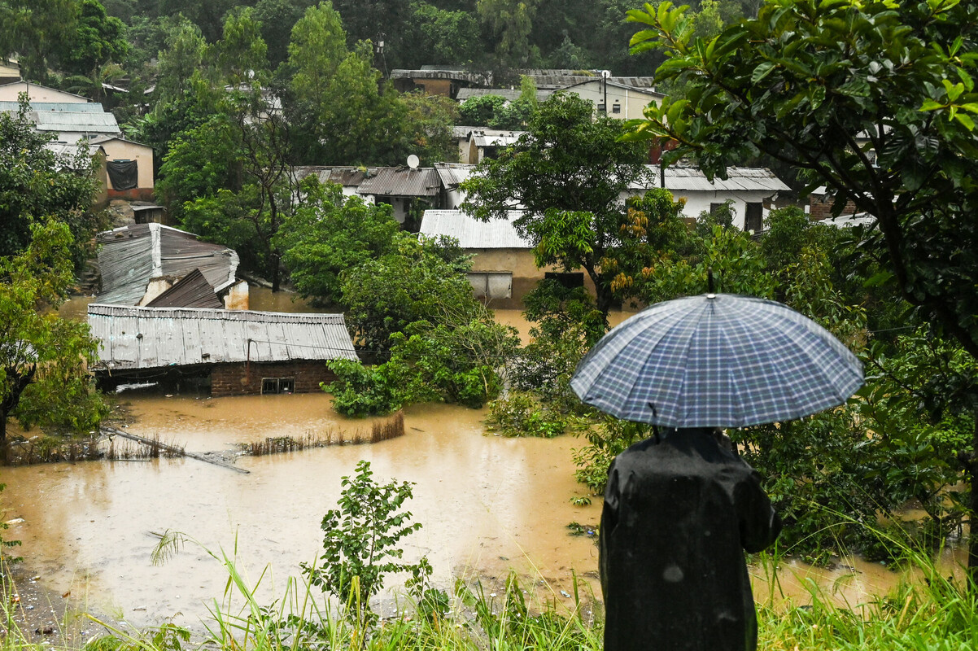
3 Loss and Damage
Flooding damage caused by
Cyclone Freddy, Malawi, Southern Africa. March 2023
Photo: Thoko Chikondi/Oxfam
Notes:
Slide 5 - Loss and Damage
Unfortunately disasters, like storms and floods, have always been part of life. When a disaster strikes, the response has usually been for charities and governments to raise money and try to help the affected people.
In recent years climate science has shown that global warming is making 'natural' disasters more frequent, more widespread and more severe. Disasters are less a case of bad luck with the weather and more a case of the changing climate.
Extreme weather driven by climate change can happen anywhere. In the UK we experience more severe winter storms and many countries in Europe and North America experience more serious summer droughts, high summer temperatures and dangerous wildfires.
However the greatest concentration of extreme weather events occurs in the tropical countries of the Global South. These countries often don't have sufficient resources to recover well from extreme weather events.
Loss refers to somethng which is lost forever because of a disaster - for example crops and animals that die in a drought. Damage refers to something that is damaged and can be repaired - for example the houses damaged by flooding in the photo.
The COP27 climate change conference in 2022 finally agreed to set up a loss and damage fund to compensate countries for climate disasters. Loss and damage is no longer simply down to charity. However the countries mainly responsible for climate change have not yet promised nearly enough money for the fund. This is one of the greatest climate justice challenges facing the world as the cost of loss and damage is massive. A recent report estimates the fund may need $100 billion per year.
The photo shows loss and damage caused by Cyclone Freddy in Malawi in March 2023. Tropical storms that once mainly affected the coastal areas of East Africa now more freqently extend further inland to landlocked countries such as Malawi and Zimbabwe.

Slide 6
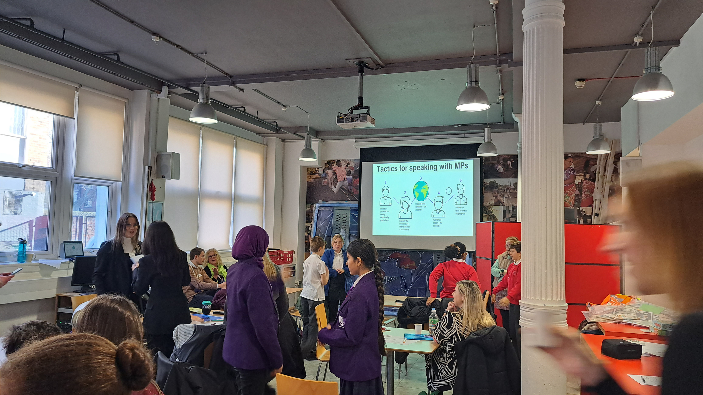
Time to Get Creative
for Climate Justice
Get Creative learning workshop on how to influence MPs
Photo: Christian Aid
Notes:
Slide 6 - Get Creative for Climate Justice
When people think about 'climate action' they very often think mainly about reducing their carbon emissions.
As we've seen (slide 3) this is an important part of the solution. But it remains controversial as countries have not yet agreed by how much and how fast they should cut their greenhouse gas emissions so it's fair for everyone. Countries emit very different amounts of greenhouse gases and have been doing so for different lengths of time. This is an important part of the climate justice question which could be communicated in your art or creative writing.
Most people do not think about climate finance and loss and damage at all when they think about 'climate action'.
However even when the world reaches 'net zero' emissions, the effects of climate change will be long lasting and global heating has already caused severe loss and damage.
These effects have been, are and will be most strongly felt in the countries of the Global South. These countries are in the front line of climate change yet have done the least to cause it. Climate justice calls for the countries who have become wealthy through their greenhouse gas emissions to take greatest responsibility for climate finance and loss and damage. In particular it's proposed that the companies and individuals who make the greatest greenhouse gas emissions should pay more tax to help pay for loss and damage they have helped cause. This is called 'Make Polluters Pay'. How could your art or creative writing represent these ideas?
Your role is to create a piece of art or creative writing which clearly communicates your call for climate justice. You may use whichever medium or materials you wish provided your work can be displayed on A1, A2 or A3 paper. Your work must be respectful and inclusive, and you should feel proud for it to be seen by MPs and Ministers. Please also give your work a title, write a brief caption to explain it and tell us your first name and your school's name.
Good luck and thank you

