Slide 1
Notes:
Note: this script aims to comprehensively explain the Families Together campaign and some detail may be excluded depending on the audience. Statistics are cited with their sources; they are not intended to be part of the presentation. Photographs are credited and dated. Please adapt the presentation to fit your purpose.
Begin
No matter who we are or where we live, we all want to live in a place of safety with our families. A place we can call home. The COVID-19 pandemic temporarily separated many of us from our loved ones, so this is a human need everyone remembers.
But conflict, persecution and disaster have made home and family distant memories for millions of people.
At the end of 2022, 108.4 million people were displaced from their homes by war, violence and persecution. This is a massive number and represents about one in 74 of all people on earth. The global number of people forced to flee has grown quickly in a short period of time, from 43.3 million in 2009 to the record numbers of today.
The millions of people fleeing war in Ukraine is one reason for the rapid increase in the number of displaced people between 2021 and 2022. But during the same year more than 1 million additional people were displaced in each of Democratic Republic of the Congo, Ethiopia and Myanmar.
Statistics
UNHCR (2023) – ‘Global Trends. Forced Displacement in 2022’
Glossary
Displaced person: a displaced person seeks safety by moving to another part of the country where they live.
Refugee: a refugee seeks safety by crossing a border into another country.

Slide 2
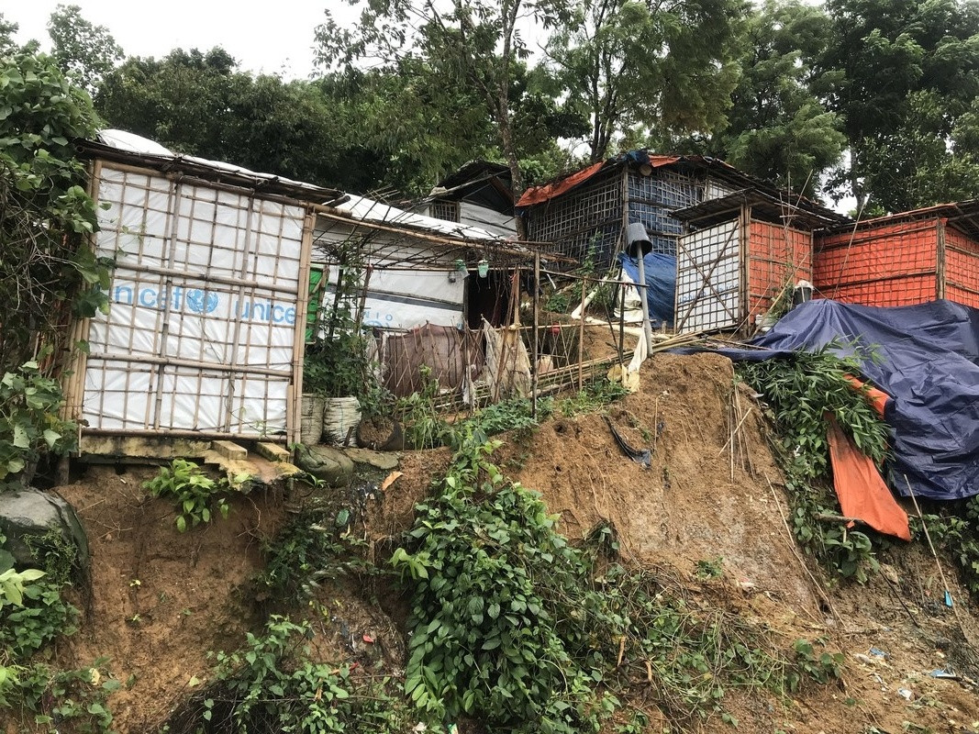
Cox’s Bazar, Bangladesh
Notes:
The vast majority of the people forced to flee their homes by war, conflict and persecution are hosted by a country in the Global South, usually a neighbouring country. For example, the photo shows some of the appalling conditions in the world’s largest refugee camp. It’s in Cox’s Bazar in Bangladesh. In March 2023 it was home to 639,692 Rohingya refugees who have fled across the nearby border to escape persecution and violence in Myanmar
Oxfam has humanitarian programmes providing water, sanitation and food in many of the countries that host the largest numbers of refugees, such as Bangladesh, Syria, Uganda, Lebanon, Jordan and Tanzania.
Photo: Mutasim Billah/Oxfam, 9 July 2019
Data
UNHCR (2023): https://data.unhcr.org/en/documents/details/100047

Slide 3
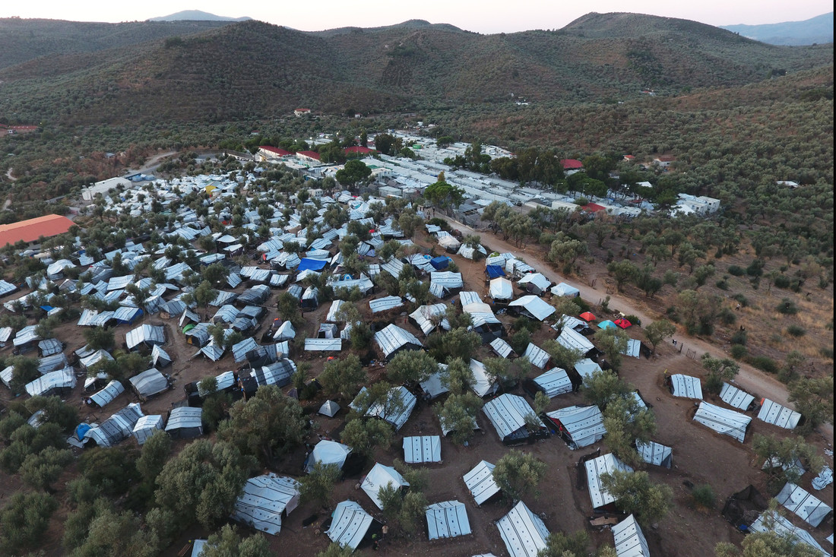
Lesbos, Greece
Refugees in Europe
Notes:
Although the numbers are smaller, refugees are also seeking sanctuary within Europe.
This is an aerial view of the makeshift settlement next to Moria camp on the island of Lesbos, Greece. Thousands of refugees who have crossed the sea from Turkey were living here in extremely poor conditions without running water and electricity. They lived in the dark while being exposed to worsening weather conditions during winter. In September 2020, the Moria camp was destroyed by fire, leaving 13,000 people homeless and without even the very basic shelter which is shown in the photo.
Having escaped unbearable danger and hardship, many people hope they have reached safety in Europe. But instead, they are turned away or met by hostility, discrimination, abuse – and worse.
And when people flee danger, their families are separated and split up while they’re running for their lives or undertaking long and dangerous journeys. Often family members end up in different countries or in different refugee camps; able to speak occasionally on the phone but otherwise separated.
Photo: Giorgos Moutafis/Oxfam 29 November 2019

Slide 4
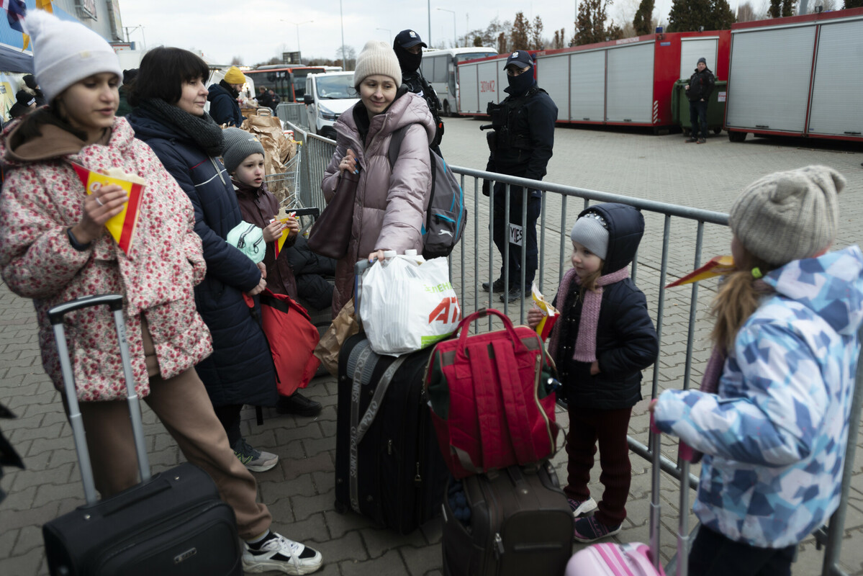
4/10 of refugees are children
Notes:
The number of displaced and refugee children has been steadily increasing, and in 2022 children made up 41% of the world’s refugees. As children make up only around 1/3 of the world’s population, they are significantly overrepresented in the refugee population.
Unlike the children in this photo, taken at the border between Ukraine and Poland, many child refugees are ‘unaccompanied’. This means they are separated from their families and arrive at a border by themselves or with groups of adults who are not their relations or responsible for them.
Photo: Bekki Frost, 10 March 2022
Data:
UNICEF (2021) – https://uni.cf/2YQuYi7

Slide 5
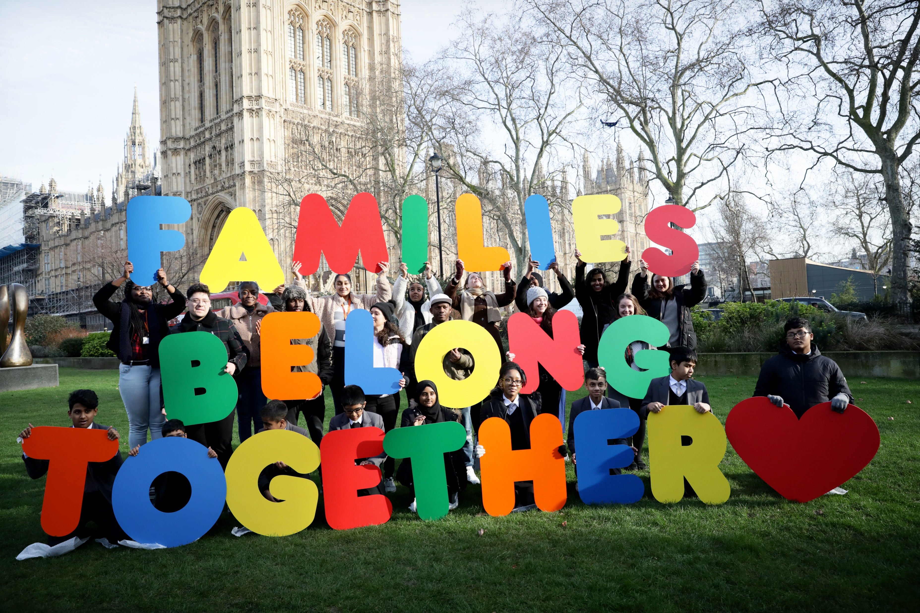
Refugees in the UK
Notes:
The number of refugees and people seeking asylum in the UK has historically been relatively small, both in relation to the overall numbers of people arriving in the UK and the numbers of asylum seekers seeking safety in other countries.
For example, between March 2019 and March 2020, the year before the Covid-19 pandemic struck, 141 million people from other countries visited the UK on holiday, 689,000 came legally to live and only 35,000 applied for asylum.
At the end of November 2022 there were 231,597 refugees settled legally in the UK and 127,421 asylum seekers waiting to hear whether their claims were successful. These numbers (a total of 359,018 people) are modest on a global scale. For example, Türkiye hosts 3,568,300 refugees, Colombia hosts 2,455,500, Uganda hosts 1,463,500 and Poland hosts 971,100. The UK is not a primary destination for the world’s refugees. Most refugees flee to a neighbouring country and most host countries are in the Global South. For example, many Syrians flee to Turkey, Venezuelans to Colombia, Congolese and South Sudanese to Uganda and Ukrainians to Poland.
While people seeking asylum in the UK wait for their claims to be decided they are not permitted to work and must rely on the government for support. They are told where to live and are given £47.39 per week to cover all their other needs. This is too small an amount to live on with dignity. Asylum claims can take many months or even years to decide and the number of people waiting to hear the result of their claims has been rapidly increasing.
Once a person’s refugee status is granted, they may work and claim similar benefits and government services as everyone else. However, the UK’s rules about refugee family reunion are strict. A refugee is only permitted to sponsor their partner, children under 18 and, in exceptional circumstances, dependent children over 18 to join them in the UK. This means that families that become separated as they flee often remain separated from other family members once they are granted refugee status. This is despite the evidence showing that people living together with their loved ones find it much easier to integrate with a new society.
Photo: Marie-Anne Ventoura / Amnesty International UK. 5 February 2020
Data:
National Statistics (2020)
UNHCR (2023) https://www.unhcr.org/uk/asylum-uk
UNHCR (2023) https://www.unhcr.org/global-trends-report-2022
UK Government (2023) https://www.gov.uk/asylum-support/what-youll-get

Slide 6
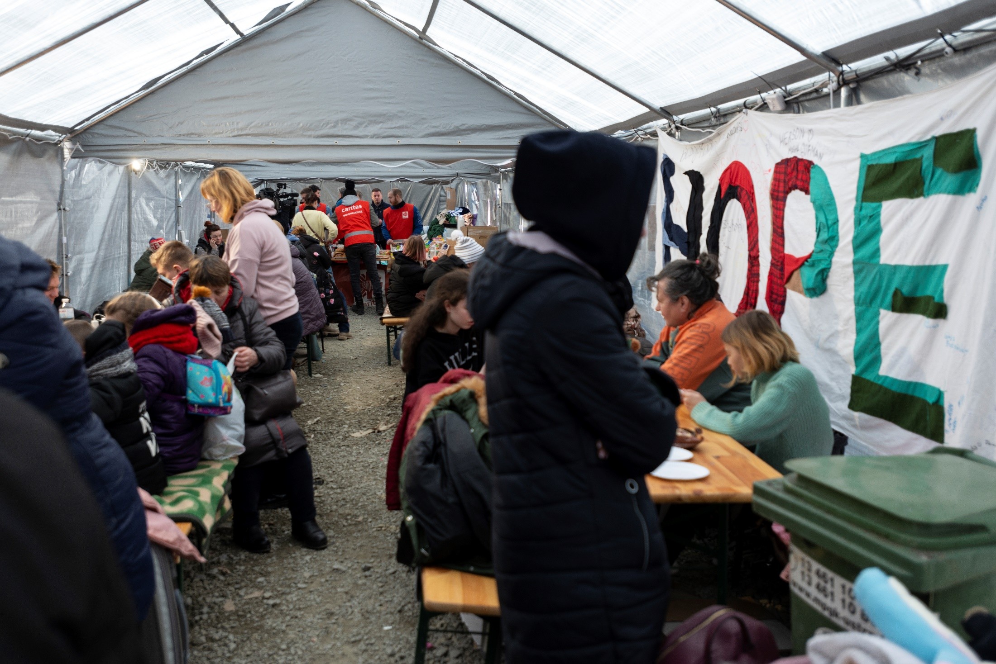
Refugees from Ukraine
Notes:
In February 2022, the war in Ukraine suddenly triggered Europe’s largest movement of refugees since World War 2. By 10 April 2022 just over 4.5 million people had sought safety in neighbouring countries. The welcome extended to Ukrainians fleeing conflict by British people has been generous, compassionate and kind. By May 2023,174,000 Ukrainian refugees had entered the UK.
The Government has shown generosity to Ukrainian refugees and their families, including broadening the definition of the family members permitted to settle in the UK and the speedy confirmation of settled status. However, the position of asylum seekers and refugees who have fled other conflicts such as Syria, Iraq, Afghanistan and further afield is less secure. The United Nations Convention on Refugees and international law require governments to welcome all refugees wherever they have come from.
Photo: Refugees at a reception centre on the Ukraine/Poland border – Bekki Frost/Oxfam, March 2022
Data
UNHCR (2022) – ‘Operational Data Portal. Ukraine Refugee Situation’
Migration Observatory (2023) – Ukrainian Migration to the UK.

Slide 7
Change the rules
Notes:
The Families Together campaign is calling for a change in the rules about refugee family reunion.
At present the only family members of refugees legally entitled to resettlement in the UK are a refugee’s partner, their children under 18 years old and, in exceptional circumstances, dependent children over 18. Other family members do not qualify.
Therefore, the Families Together campaign calls for the following
All refugees are treated equally and fairly, no matter where they are from
Expand the definition of family so that sick or elderly parents who are dependent on their family in the UK can live here in safety with their families
Reunite children with their parents. Child refugees in the UK should have the right to sponsor their close family to join them.
Bring back legal aid, so refugees have the support they need to make the complicated applications to sponsor family members to join them.
Refugee rules can be changed by the Home Secretary without a new law. So, it’s important to show MPs from all parties that young people are calling for change. This is how to convince MPs to take action in Parliament and help change the rules.
Here’s how you can have your say and help to bring refugee families together.
Think about creative ways of how you could collect messages to send to your MP. We have some templates you could use, but also think creatively and design your own ideas. The campaign has been using the idea of jigsaw pieces to represent the missing pieces in families’ lives, so you could be creative and design your own jigsaw pieces.
When you’ve finished collect all your messages together to send to your MP. If it’s possible meet your MP online or face to face to explain your campaign and why you’re calling for refugee family reunion.
And if you’re a school who has joined Schools of Sanctuary, you may submit this campaign in your portfolio

Slide 8
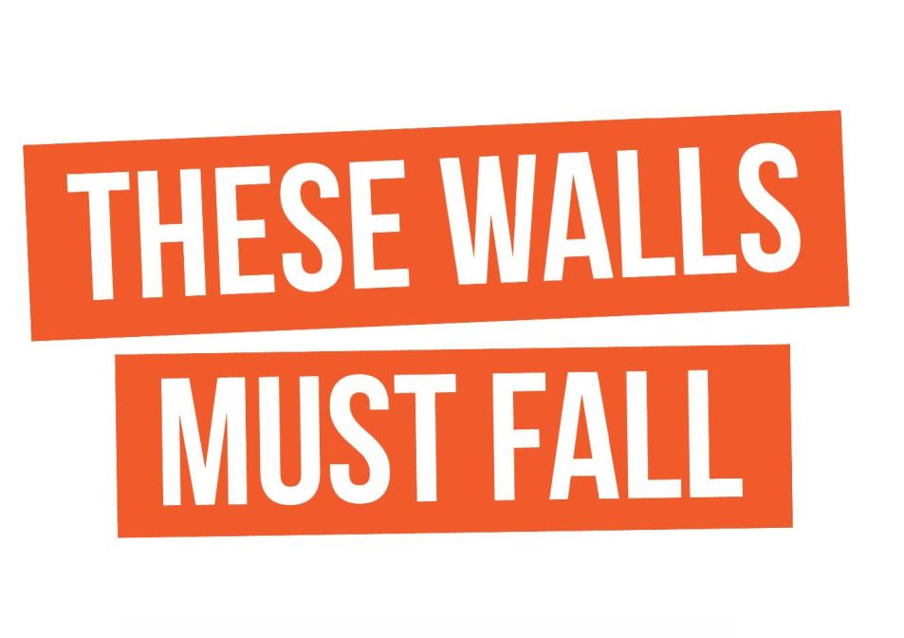
Notes:
Finally, Families Together is one of many campaigns which challenge different aspects of the UK’s asylum and refugee system.
Here are several others. You could also research these campaigns and get involved to support their aims.
Thank you

