Slide 1







OUR MANIFESTO FOR THE WORLD
Giving Young People a voice in the UK General Election

Slide 2



Understanding the General Election as a Global Citizen
What does it mean to be a Global Citizen?

Slide 3
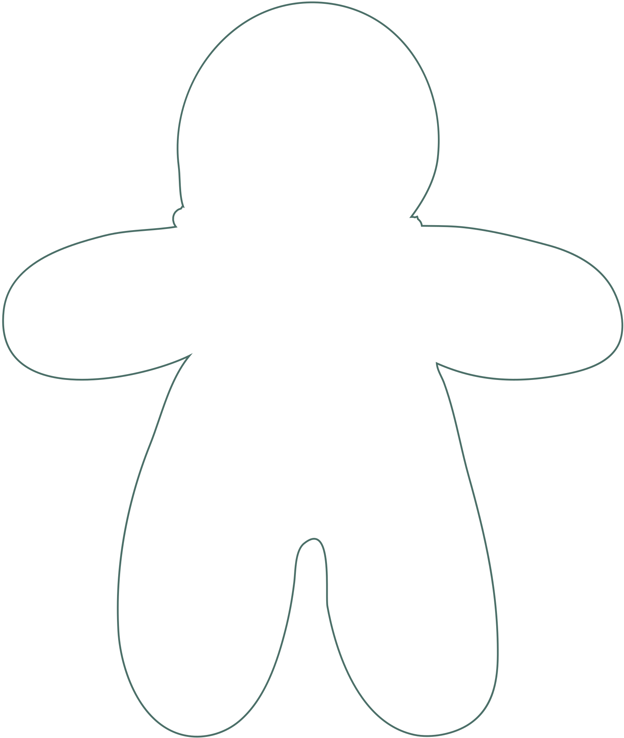

Head, Heart, Hands
Think
(Knowledge)
Feel
(Values)
Do
(Skills)

Slide 4
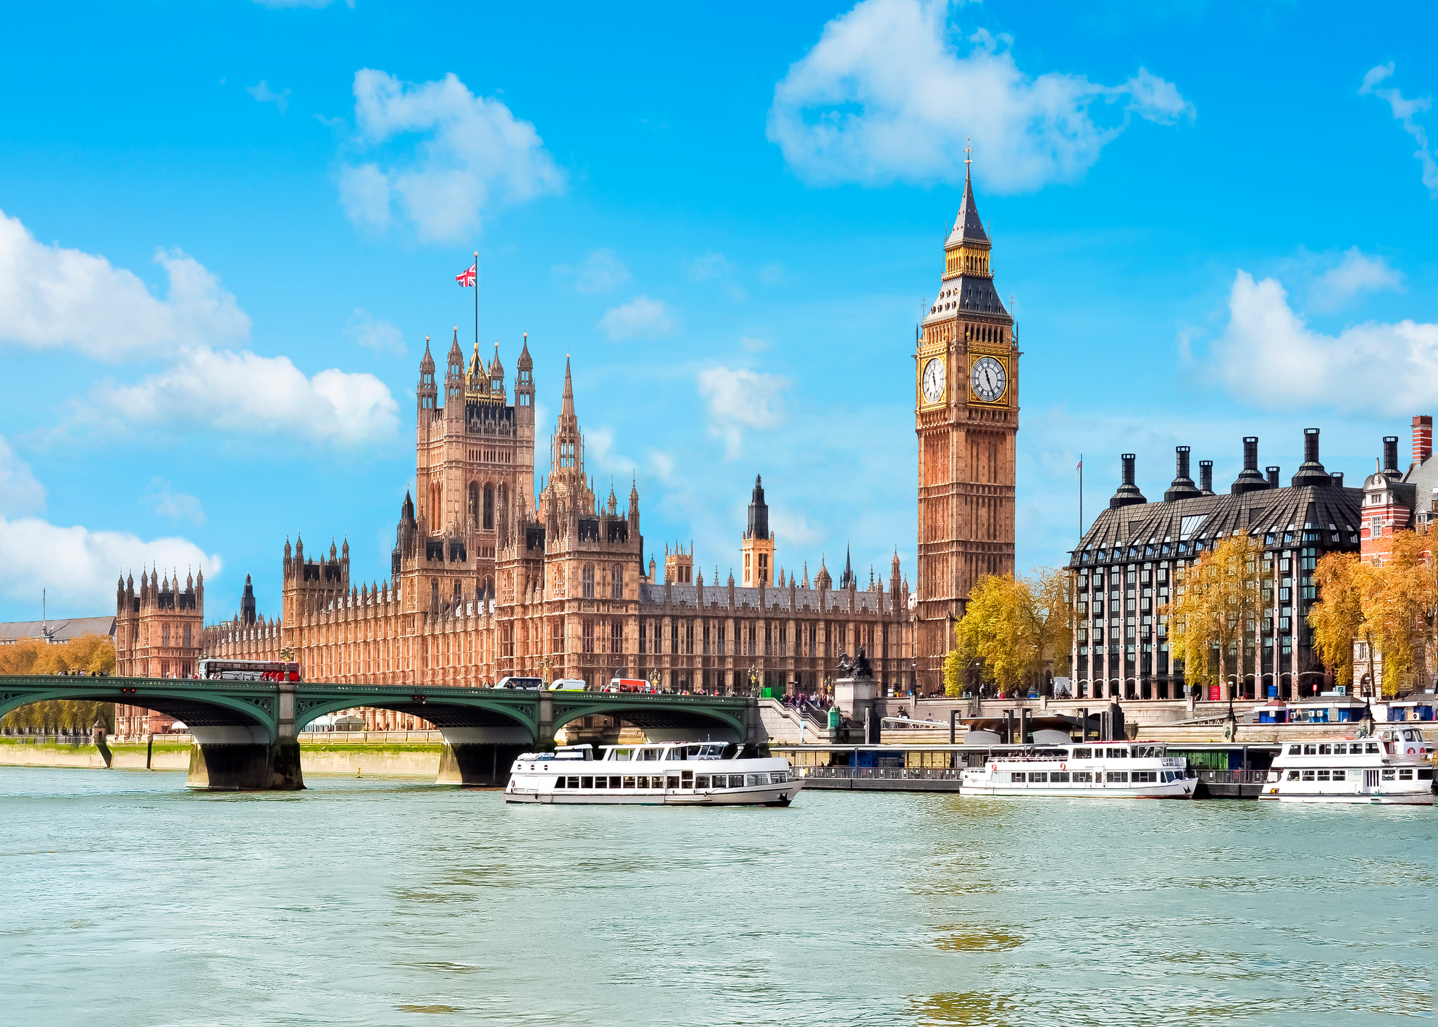
What is a general election?
photo credit: Canva 2024

Slide 5


Slide 6

What is a general election?
Task: Match the correct definition to the word
The House of Commons is where MPs debate issues, policies and proposed laws. They will ask questions of the government and Prime Minister and vote on issues here.
House of Commons

Slide 7


What is a general election?
Task: True or False

Slide 8


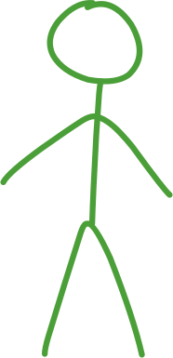





Me and the world
Colour 1: What are my values and what characteristics do I want to be known for? (Look back at the gingerbread person from earlier in the lesson)
Colour 2: What do you think would make the world a better place? What issues do you care about?
Colour 3: Draw lines to link the values and characteristics to the issues that you care about (eg, you might draw a link between the value of ‘kindness’ and the issue that ‘no one should have to experience poverty’).

Slide 9

Plenary
  What is a general election and why is it important to us?
  What does it mean to be a global citizen?
  How does what the UK does affect the rest of the world?
  What is a manifesto, and what policies would I like to put in mine?

Slide 10
OUR MANIFESTO FOR THE WORLD
Lesson 2: Understanding the Sustainable Development Goals as Global Citizens

Slide 11





Who Am I?
“I am not the Prime Minister but I would like to be. It is my job to hold our current government to account, and I often debate with our current Prime Minister”
“I help to manage public services at a local level and make decisions about things like local parks, bin collection and local public transport”
“I am a document that political parties publish before an election to outline their ideas and policies if they get elected”
“I am politically impartial. This means I do not associate with any specific party’s politics, but I work to implement the government’s policies”.
“I am your local area that your elected Member of Parliament (MP) is responsible for representing in Parliament”

Slide 12



What are some of the biggest challenges facing the world today?

Slide 13


















What are the Sustainable Development Goals?

Slide 16

Diamond 9 ranking: Sustainable Development Goals
1
Most important
2
2
3
3
3
4
4
Top Tip: which goals might need to happen first to make other ones happen?
5

Slide 17



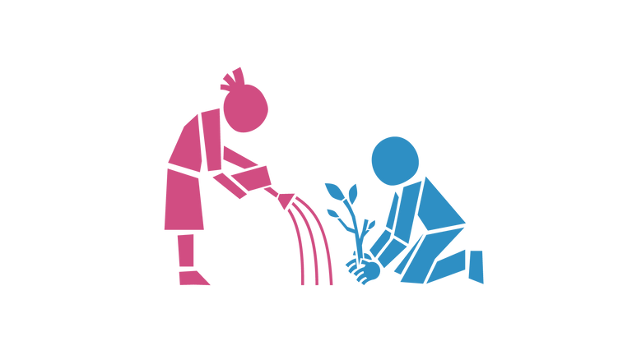
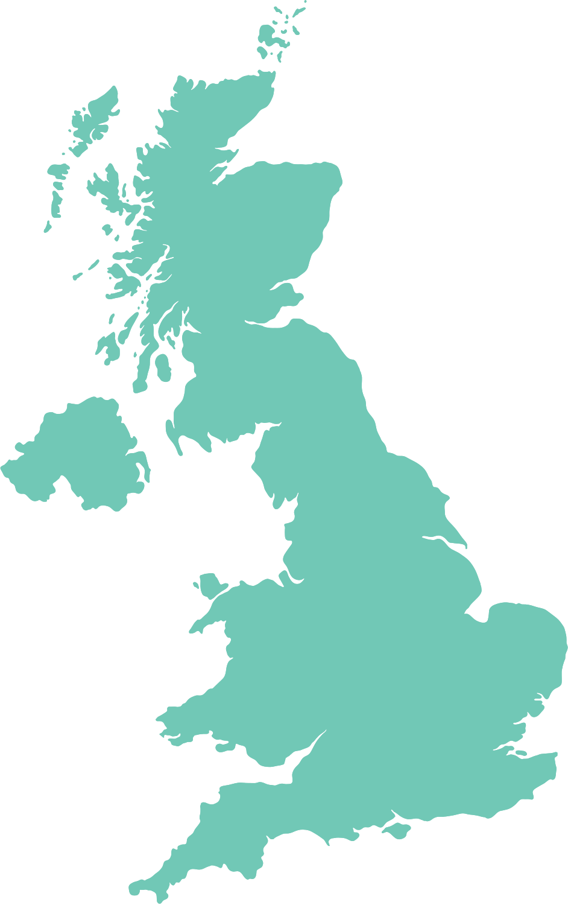
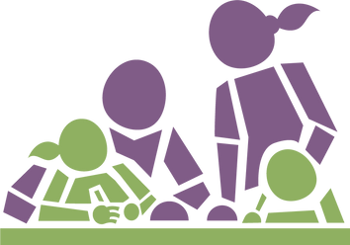



What is the UK’s role in meeting the Sustainable Development Goals?

Slide 18

Me and the world...and the UK
Colour 1: What are my values and what characteristics do I want to be known for? (Look back at the gingerbread person from earlier in the lesson)
Colour 2: What do you think would make the world a better place? What issues do you care about?
Colour 3: Draw lines to link the values and characteristics to the issues that you care about (eg, you might draw a link between the value of ‘kindness’ and the issue that ‘no one should have to experience poverty’).
What is the UK Government’s role in making the world a better place?

Slide 19

Plenary: Personal Reflection
  What does it mean to me to be a global citizen? How am I a global citizen?
  What can I do to make change on global issues?
  Which of the Sustainable Development Goals do I think are most important? Why?
  What can the UK government do to make sure the world is a fairer, and more sustainable place?
  How might I influence my newly elected MP to listen to the issues that I think are important?

Slide 20
OUR MANIFESTO FOR THE WORLD
Lesson 3: Your Voice Matters

Slide 21

Lesson 3: Your Voice Matters
Do Young People’s voices matter?
Why?

Slide 22


Lesson 3: My Voice, My Story
Think about a time that you have had influence, or felt like your voice mattered. This can be anything- big or small!

Slide 23

Creating a Class Manifesto
Our Class Manifesto is going to be our opportunity to let our newly elected MP, and the UK Government know how we want the UK to contribute to a better, and fairer world for everyone.

Slide 24

Step 1: How do we want to work together?
We are writing a shared manifesto. How do we want to work together?
  Listen to one another rather than waiting to say something yourself
  Trust each other, we are all committed to doing the work together
  Constructive feedback should be welcome!
  Use your creativity, curiosity and positivity
What else should be on this list?

Slide 25



Step 2: Individual reflection
Think about your own ideas, values, principles.
Think about the Sustainable Development Goals, and which ones you thought were most important.
Which would like to see reflected in the Class Manifesto?

Slide 26
Step 3: Think, Pair, Share

Slide 27
Step 4: Voting!

Slide 28
Step 5: Group reflection
  Why is this SDG important?
  What could it look like in practice? What types of things would happen if it was successfully implemented?
  How does this idea/value improve life for others?
  How does this SDG reflect your group’s values?

Slide 29


Step 6: Drafting it together
Structure:
  Introduction
  Our shared values
  3-5 Sustainable Development Goals that we think would make the world a fairer place
  What is the UK’s role in achieving the Sustainable Development Goals?
  How do our values shape what we want the world to look like?
  Conclusion

Slide 30
Step 7: Sharing our manifesto- what shall we do next?
  Use the press release template to share with local papers the ideas, hopes and visions of local children and young people.
  Write to your newly elected MP after the election and ask them to support your manifesto.
  Invite your newly elected MP to school and present them with your manifesto.
  Turn your manifesto into posters that you put up around your school or community area to share with others.
  Create a strong visual leaflet, flyer or booklet to share with others.
  Let Oxfam, Christian Aid, Send My Friend and Cafod help! Share your stories, manifestos, and videos with us and we can share them too.
What other ideas do you have?

