Slide 1
Mapping Climate Justice
Question: what does climate justice mean?
Notes:
Ask for a volunteer to answer the question. Answer is on the next slide.

Slide 2
Answer: Climate Justice means that the impacts of climate change are not experienced equally around the world; and the people who did the least to cause climate change are often experiencing its worst impacts.

Slide 3
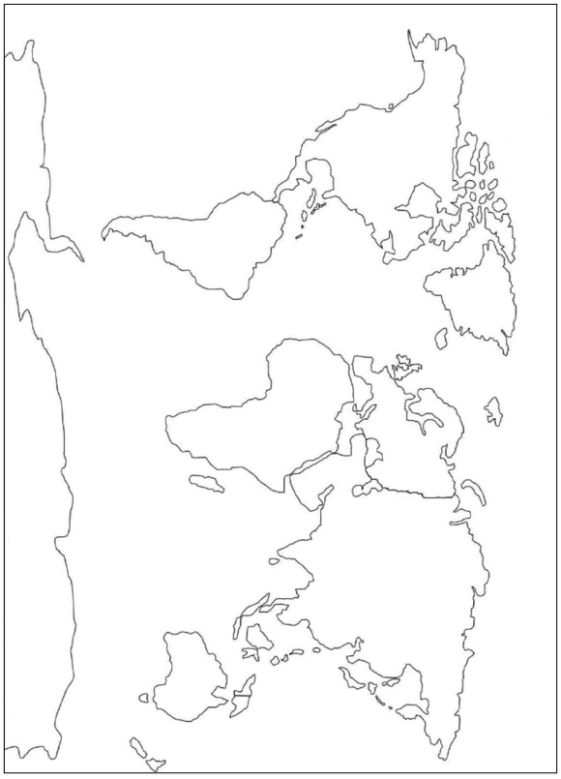
You need 2 colour pencils
  In one colour quickly shade in the countries/areas which you think are most vulnerable to climate change.
  In another colour quickly shade in the countries/areas which you think are most responsible for causing climate change.
Notes:
Once pupils have had a minute to discuss their answers invite pupils to come up to the white board and using a red pen colour in areas that they think are most vulnerable to climate change. and using a blue pen invite them to colour in the areas they think are most responsible for causing climate change.

Slide 4
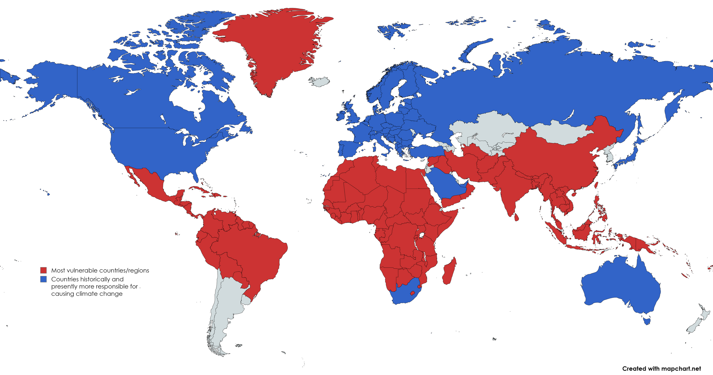
Compare this Map with the map you coloured in.
What do you notice about this map?
Is there anything that surprises you?
Notes:
This map provides a basic overview of the split between countries and regions that are historically, and presently, responsible for causing climate change (blue), and in red the countries and regions that have historically, and presently, experiencing the worst effects of climate change.
Key points to make clear to pupils:
This map is a broad overview and doesn't highlight all the complexity of the situation. For instance, China in recent years emits a lot of CO2, but have a huge population and are global leaders in developing renewable energy projects. Australia as a country is particularly vulnerable, but as a wealthier nation has emitted a lot of CO2 per person, and also has the economic and material resources to adapt to climate change.
This map
While it is important to highlight that climate change is a global phenomena - its impacts will be seen across the globe, wealthier nations have greater responsibility, as well as greater access to economic and material resources required to adapt.
Please be clear to communicate that while the UK, among other global northern nations, bear responsibility - it is about our past and present COLLECTIVE responsibility, not INDIVIDUALS. Pupils should not come away from this activity feeling personal guilt.

