Slide 1
THE HUMAN IMPACT OF CLIMATE CHANGE
A teaching resource for ages 9–11
Notes:
With links across the curriculum, these activities use stories, film and role play to explore the human element of the climate crisis.
Resource aims
Investigate the links between climate change and human rights.
Develop understanding of the unequal impacts of the climate crisis: why who you are and where you are in the world matters.
Explore how communities around the world are being affected by climate change, and how people are responding and adapting to these challenges.
Build empathy and promote critical thinking, debate, and discussion.

Slide 2
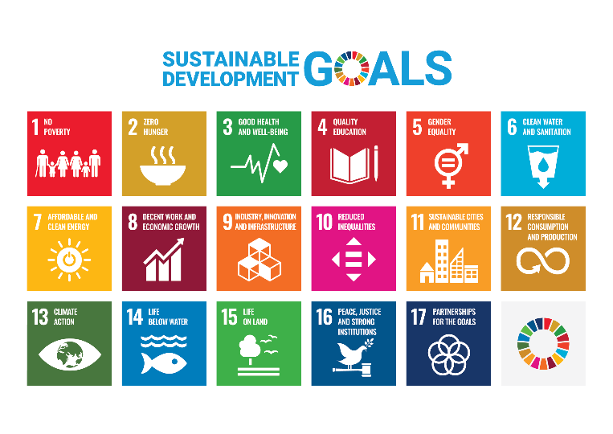

Notes:
Image: https://www.un.org/sustainabledevelopment/news/communications-material/

Slide 3
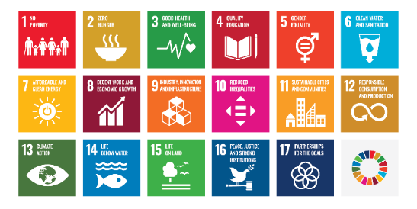
Unpredictable rainfall caused by climate change is making it difficult for many people to grow food to feed their families.
What other SDGs could this statement link to?
Notes:
Image: https://www.un.org/sustainabledevelopment/news/communications-material/

Slide 4
How is climate change making it difficult to achieve the SDGs?
How will achieving the SDGs help to tackle climate change?

Slide 5
Making it more difficult for people to grow food
Climate change

Slide 6
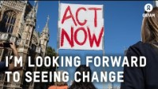
How is climate change affecting the lives of Jessy and Isaac in Malawi?

Slide 7
Climate change impacts
Changing rain patterns make it difficult to grow crops.
It is easier for mosquitos to breed when it’s hotter and wetter. This spreads diseases such as malaria.
Sudden and severe floods are more common, and people’s homes are washed away.

Slide 8
Climate change consequences
People can’t grow enough food to eat
Changing rain patterns make it difficult to grow crops
Less money to buy food
Farmers have fewer crops to sell
Parents can’t afford school fees

Slide 9
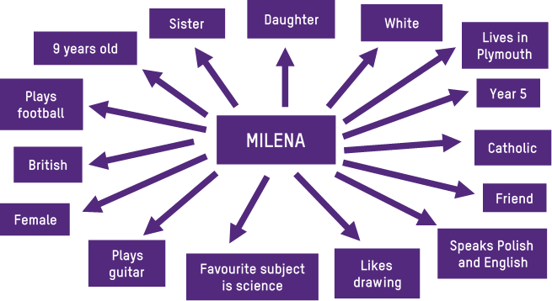

Slide 10
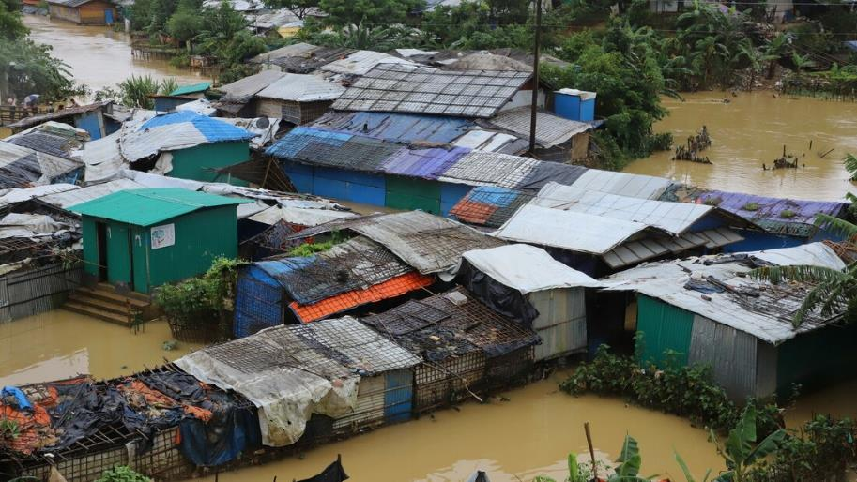
Notes:
Photo: Shaikh Ashraf Ali/Oxfam

Slide 11
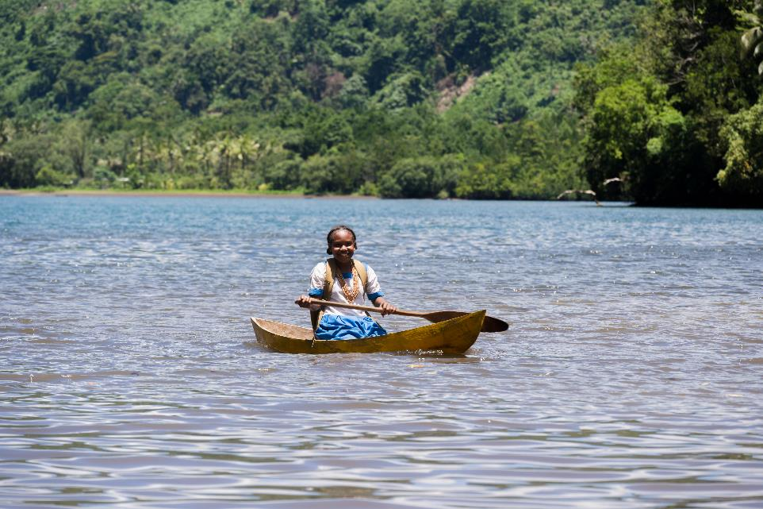
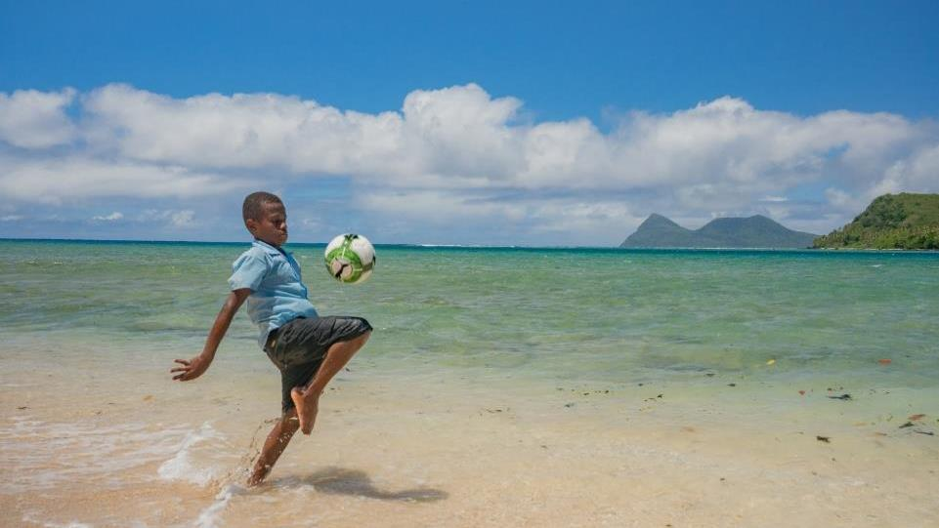
Notes:
Photo: Ivan Utahenua/Oxfam

Slide 12
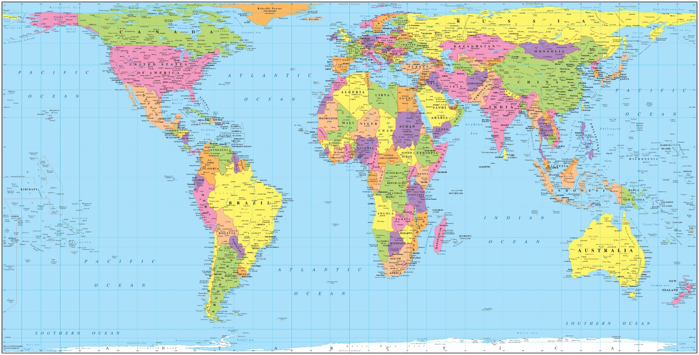
Where in the world?
Solomon Islands
Notes:
Source: © Global Media Holdings, LLC

Slide 13
Spotlight on the Solomon Islands
Solomon Islands is an archipelago of islands in the South Pacific Ocean. Climate change is affecting the lives of people here.
Land is disappearing because of rising sea levels.
Extreme weather events, such as cyclones and droughts, are happening more often. These can destroy crops making it difficult for people to grow or buy food.
Increasing sea temperatures are affecting fish and other marine life. Many people here depend on fishing to make a living.

Slide 14
Climate change stories
What do you do for a living?
Where do you live?
How is climate change affecting your life and that of people around you?
How does this make you feel?

Slide 15
Climate change stories
How are you taking climate action?
Who do you think should take action?
What else do you think needs to be done to tackle climate change?

Slide 16
Types of climate action
Adapting to climate change: Doing things differently to reduce the effects of climate change on people, plants, animals and natural systems.
Raising awareness: Sharing learning about climate change and how people can take action.
Reducing carbon emissions: Making lifestyle or other changes to reduce our carbon footprints.
Campaigning: Asking people in power to do more to reduce carbon emissions and support people to adapt to climate change.

